Slide 1
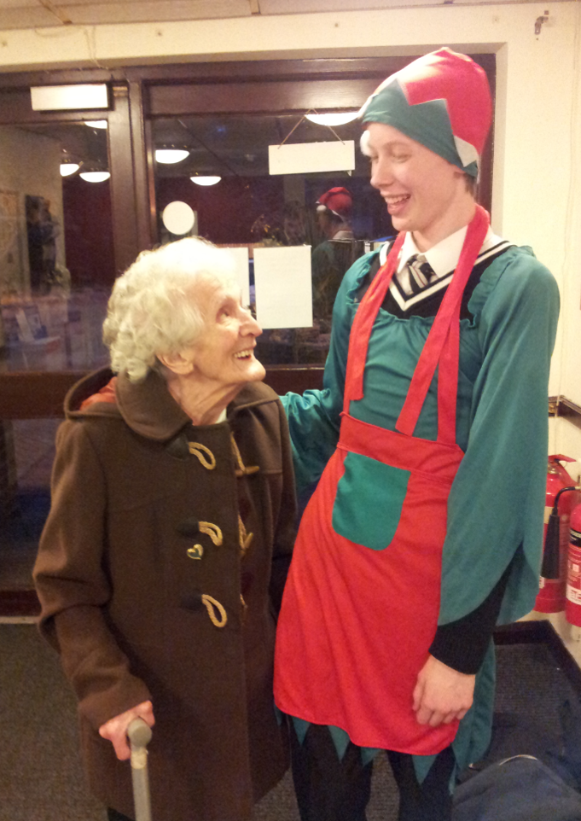
Gaining PARS points and making a difference to others at the same time
Well done from Miss Kinloch

Slide 2
We will be using the 5Rs
5 Rs | Definition
Reasoning | Same as Independent Learner (plts) means gather information and making decisions.
Reflective | Stays the same (plts) means listening to others and learning from mistakes,
Resilient | Same as Effective Participator (plts) means sticking at something you find difficult and finding ways of making it easier. Contributing to the class.
Resourceful | Same as Creative Thinker (plts) means taking risks, using your imagination and trying different learning styles.
Responsible | Same as Self Manager and Team worker (plts) means working as a team and not wasting time.

Slide 3
Our School Values;
Trust
Compassion
Forgiveness
Endurance
Justice
Friendship
Peace
Wisdom

Slide 4
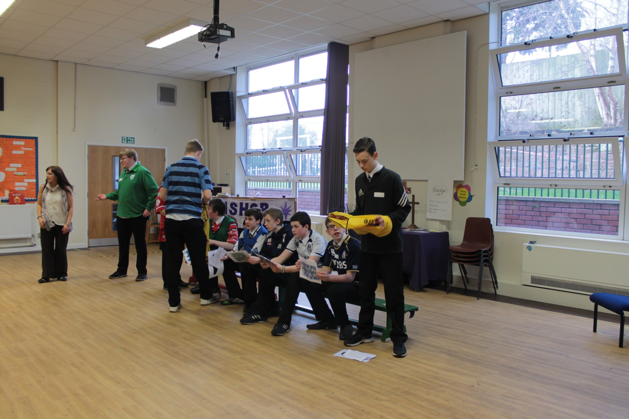
Friendship

Slide 5
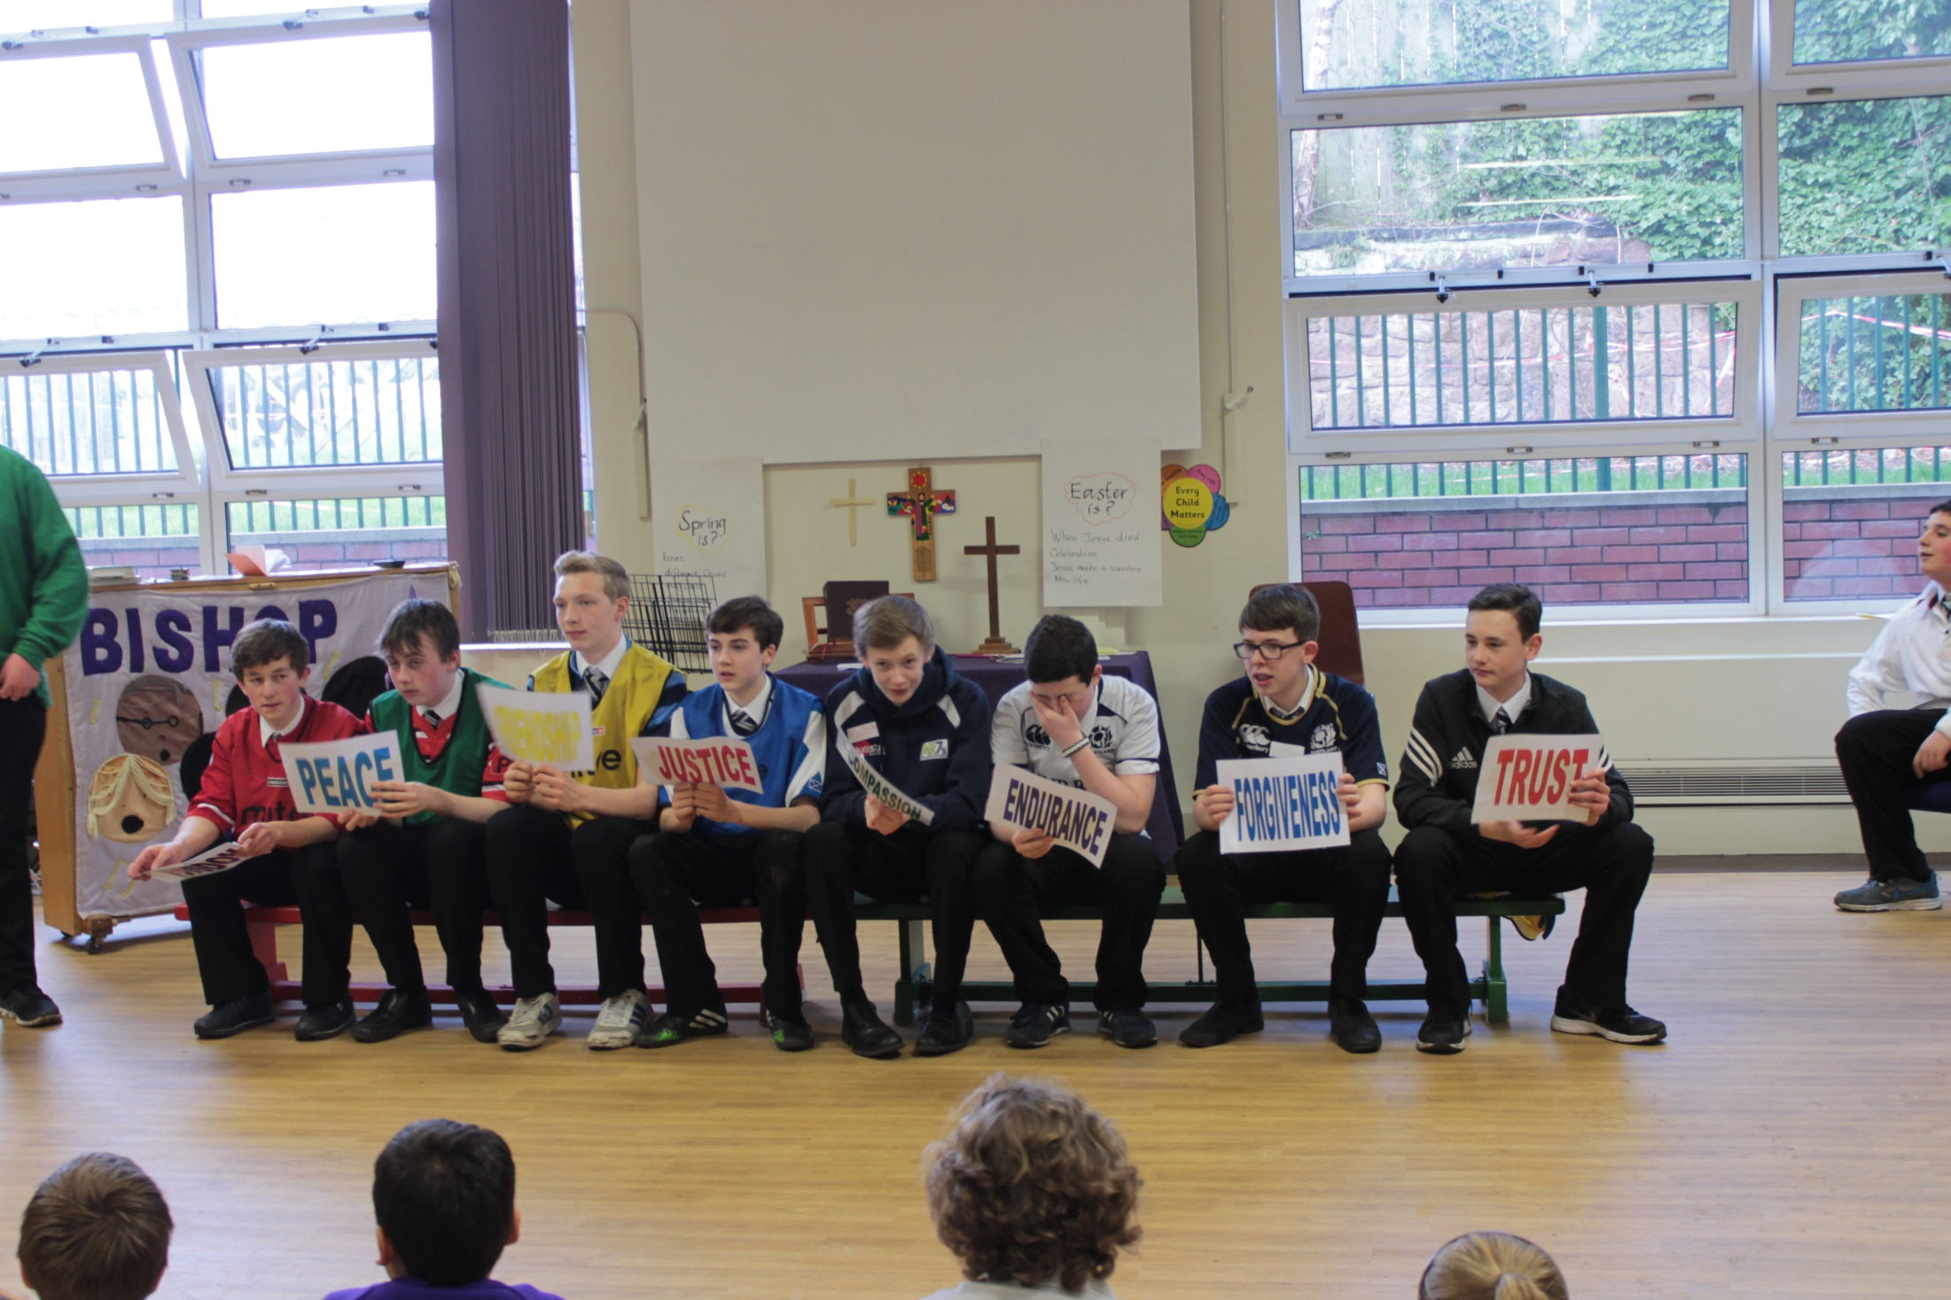

Slide 6
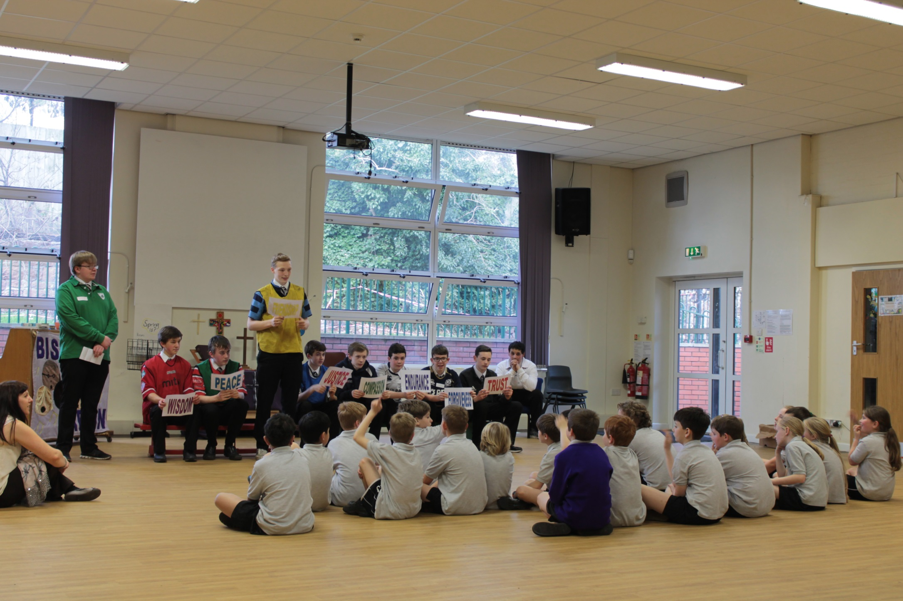

Slide 7
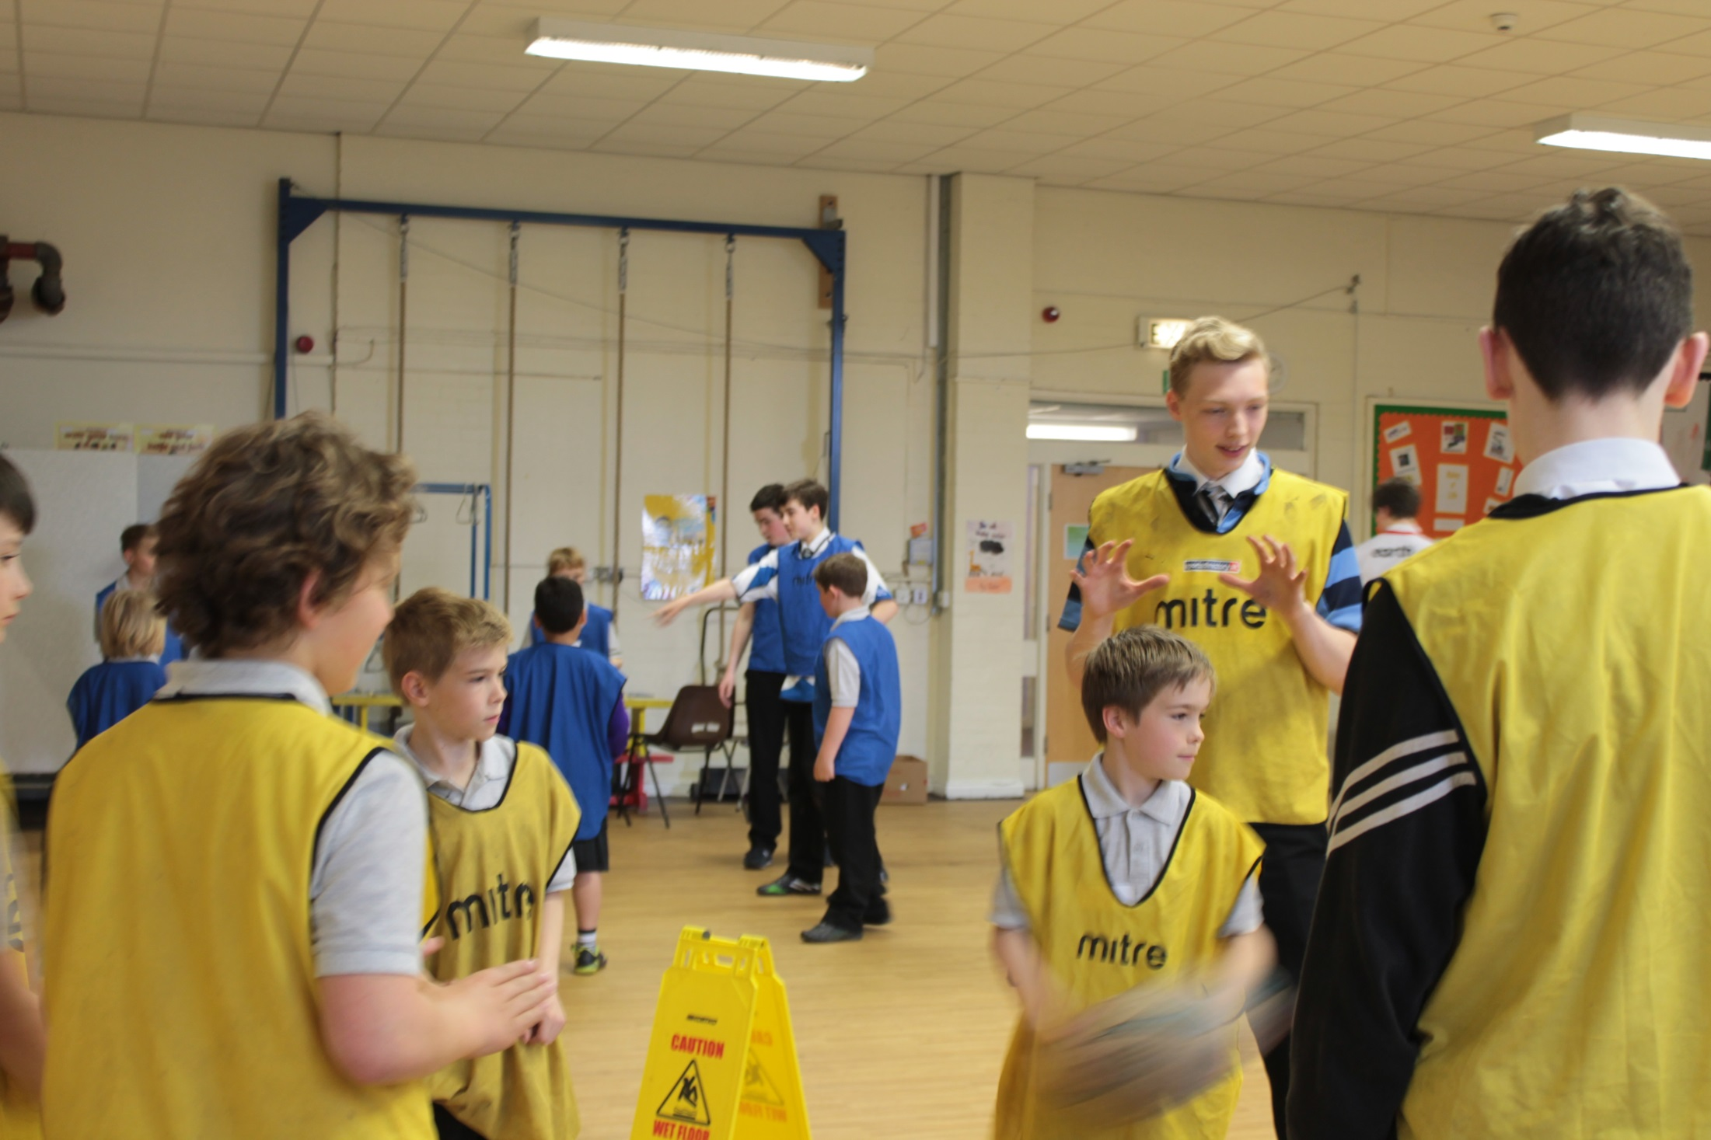

Slide 8
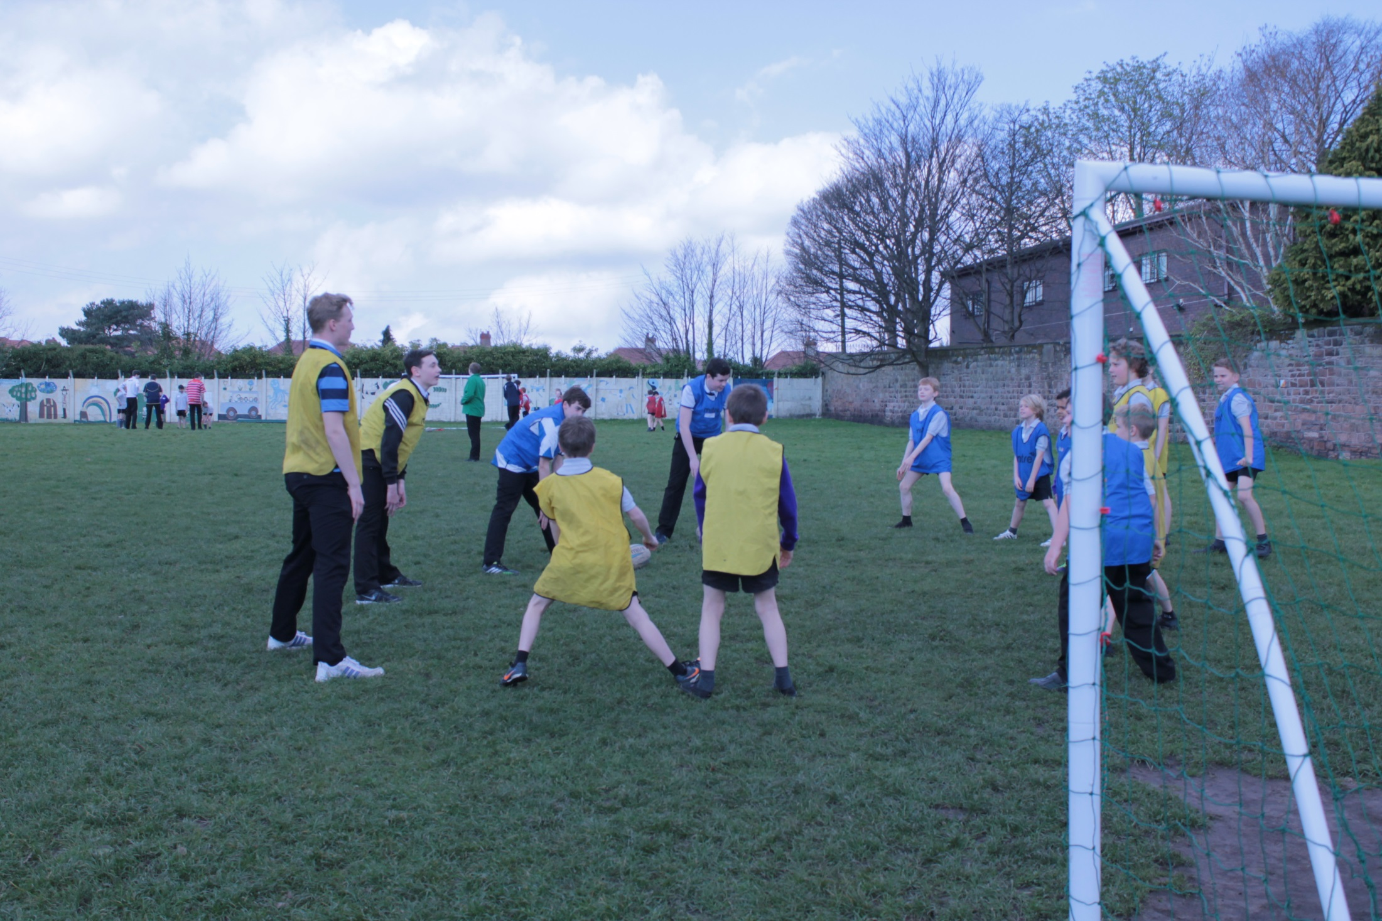

Slide 9
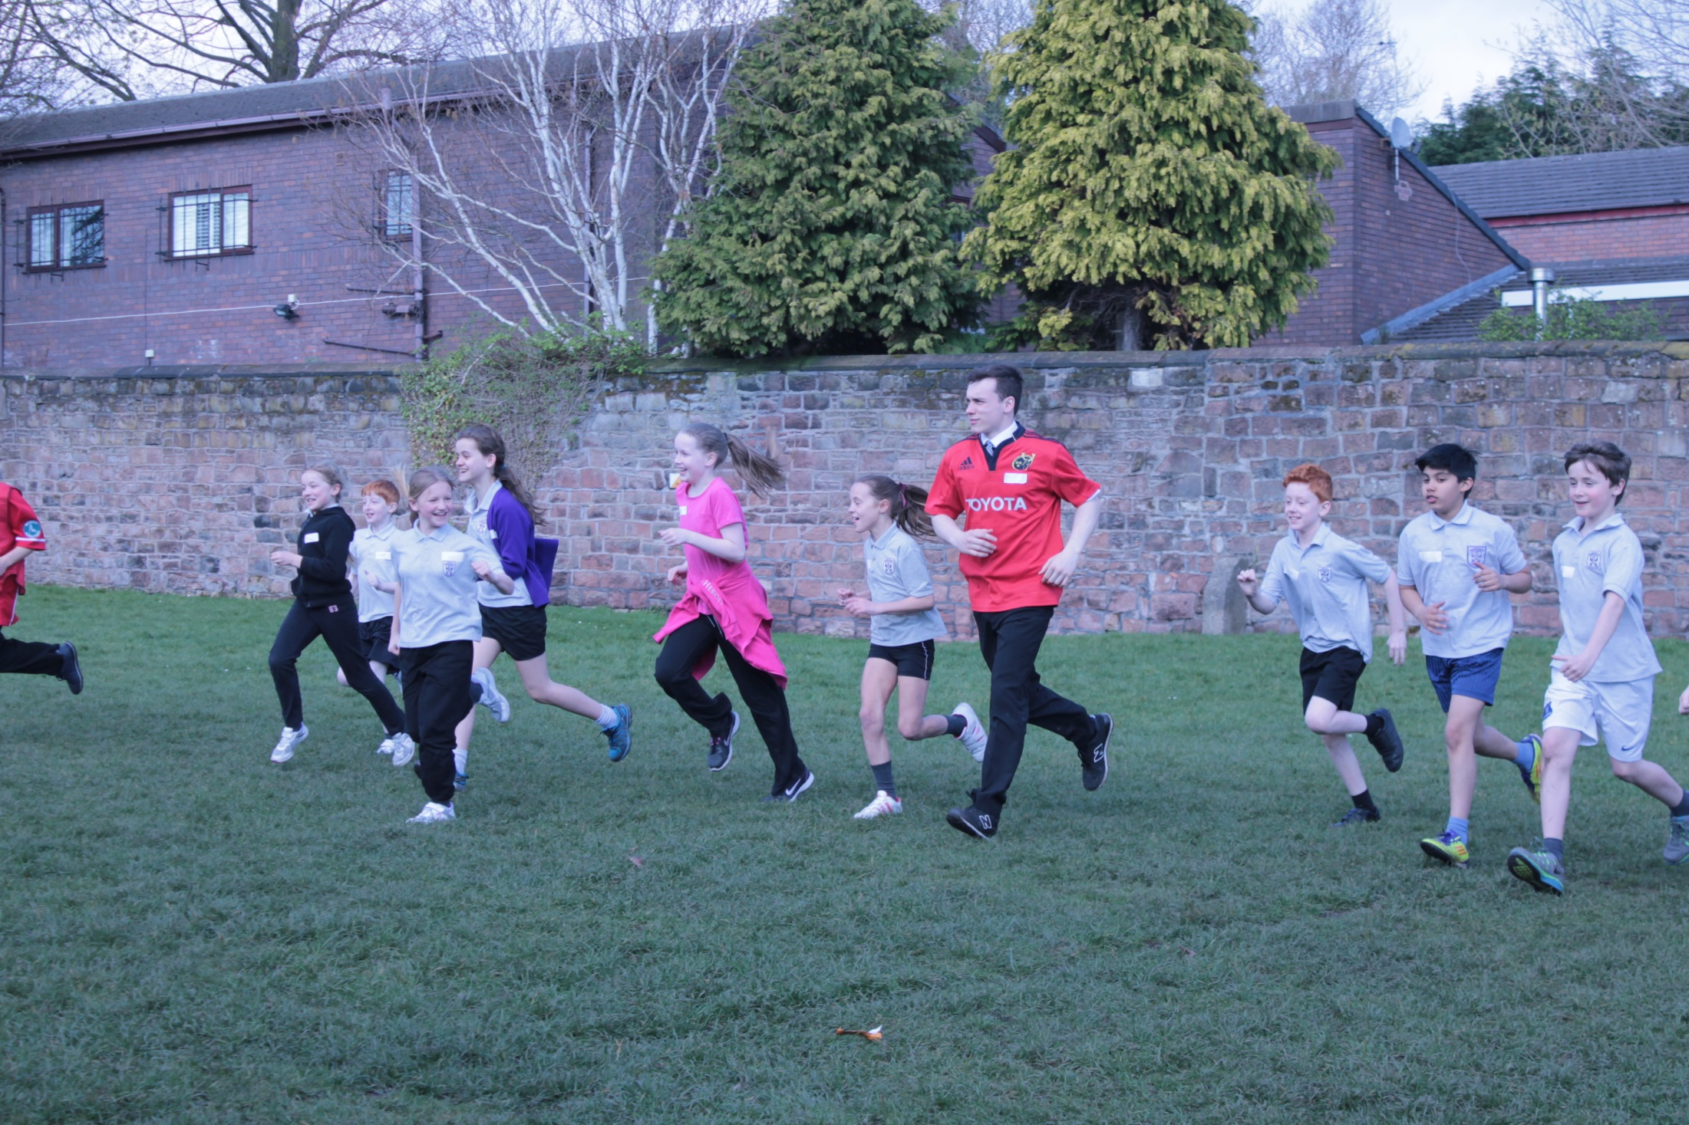
Endurance

Slide 10
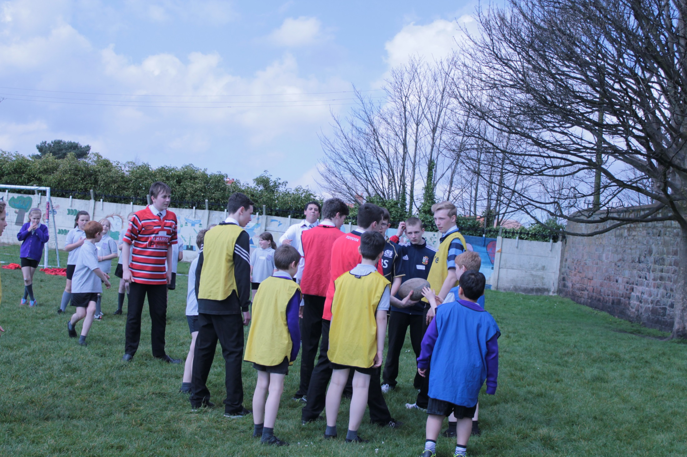

Slide 11
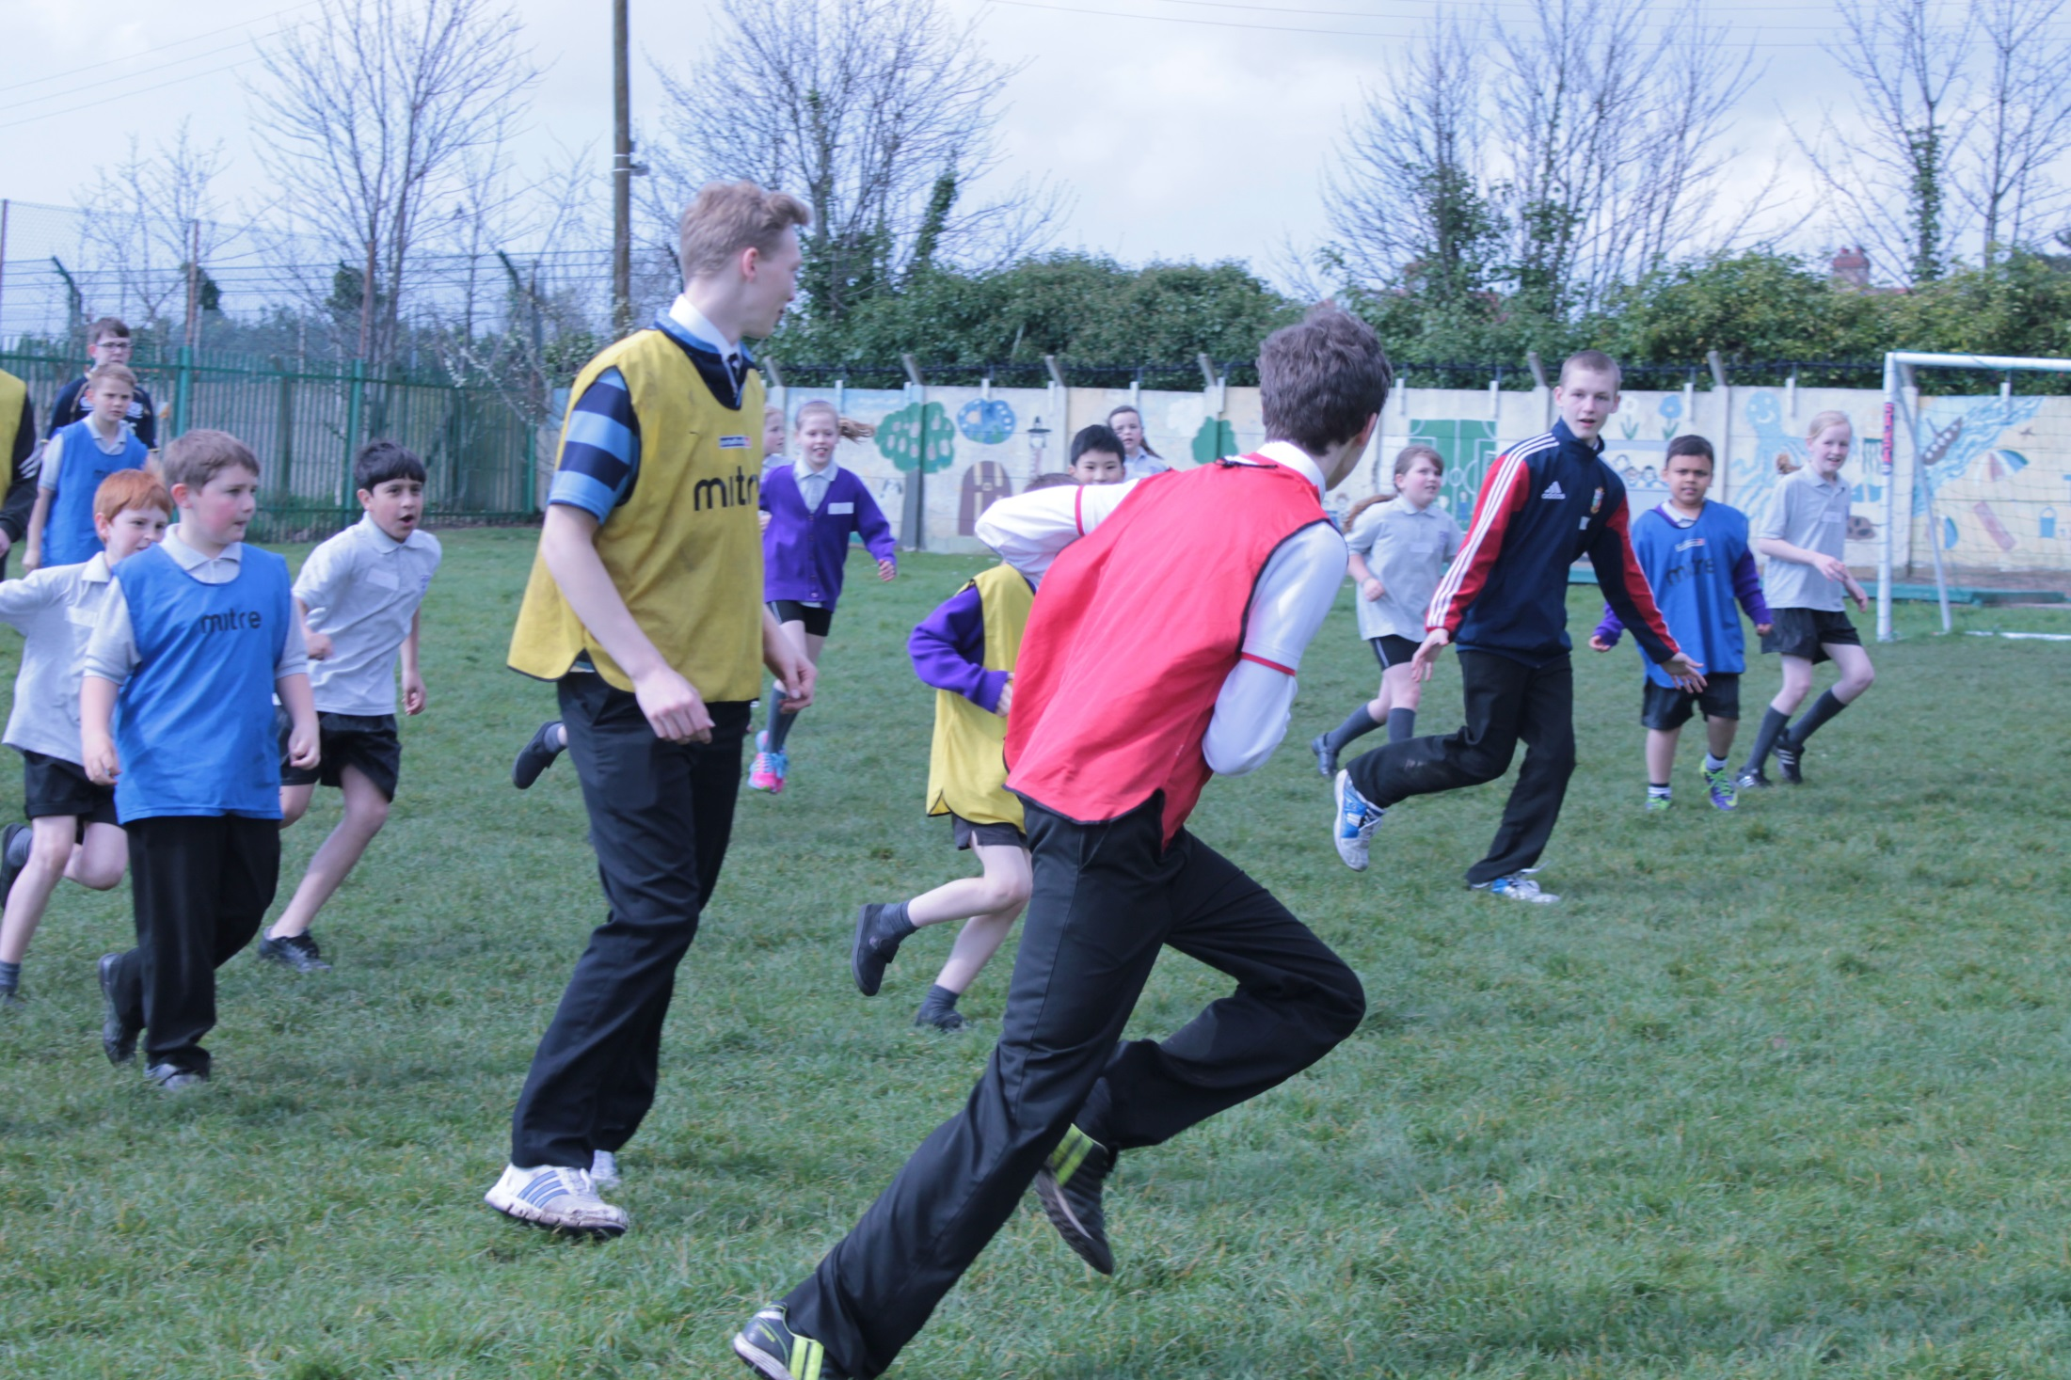

Slide 12
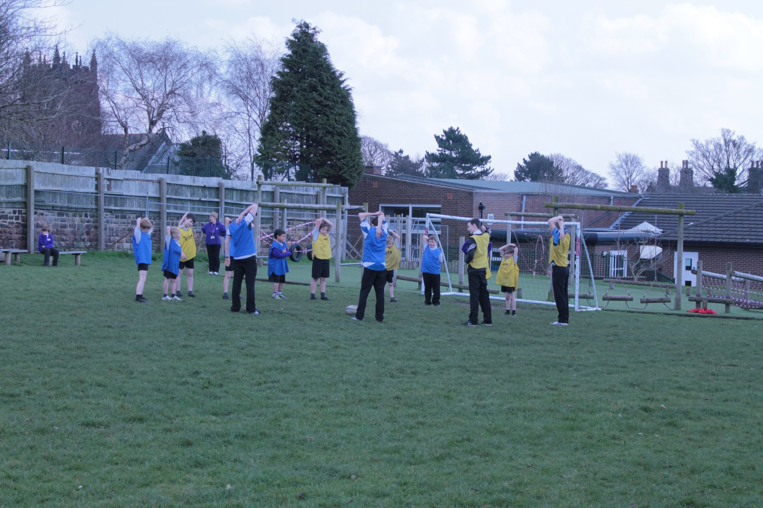

Slide 13
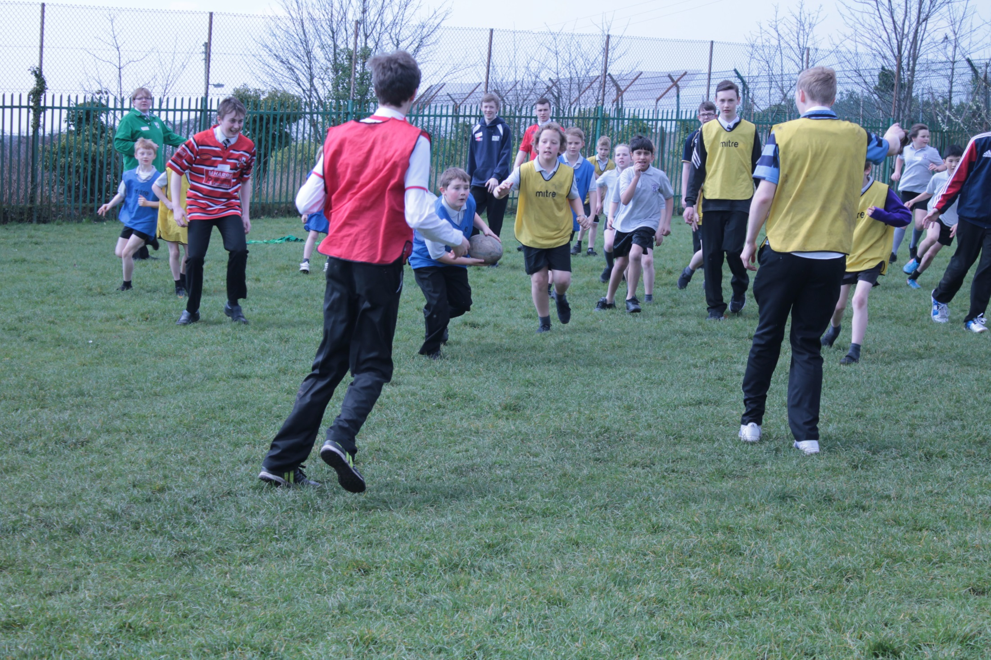
Endurance

Slide 14
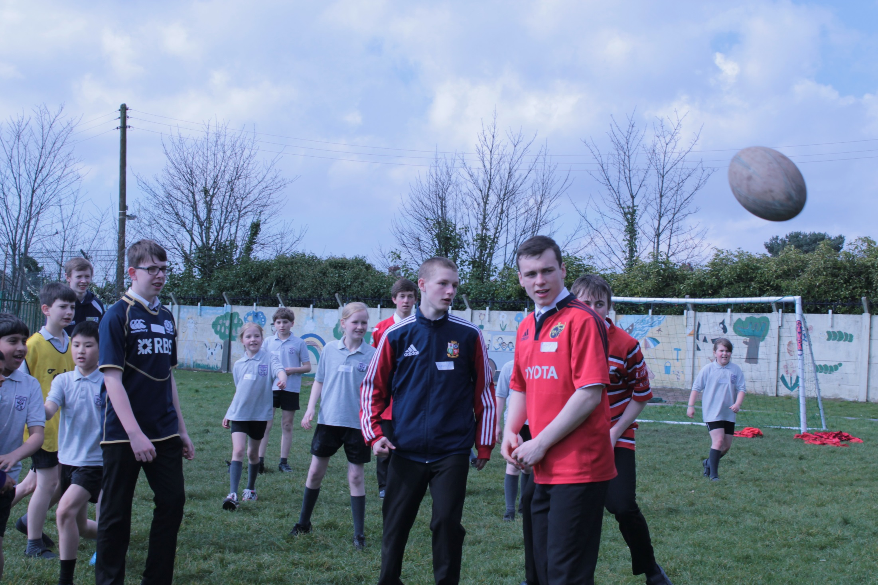

Slide 15
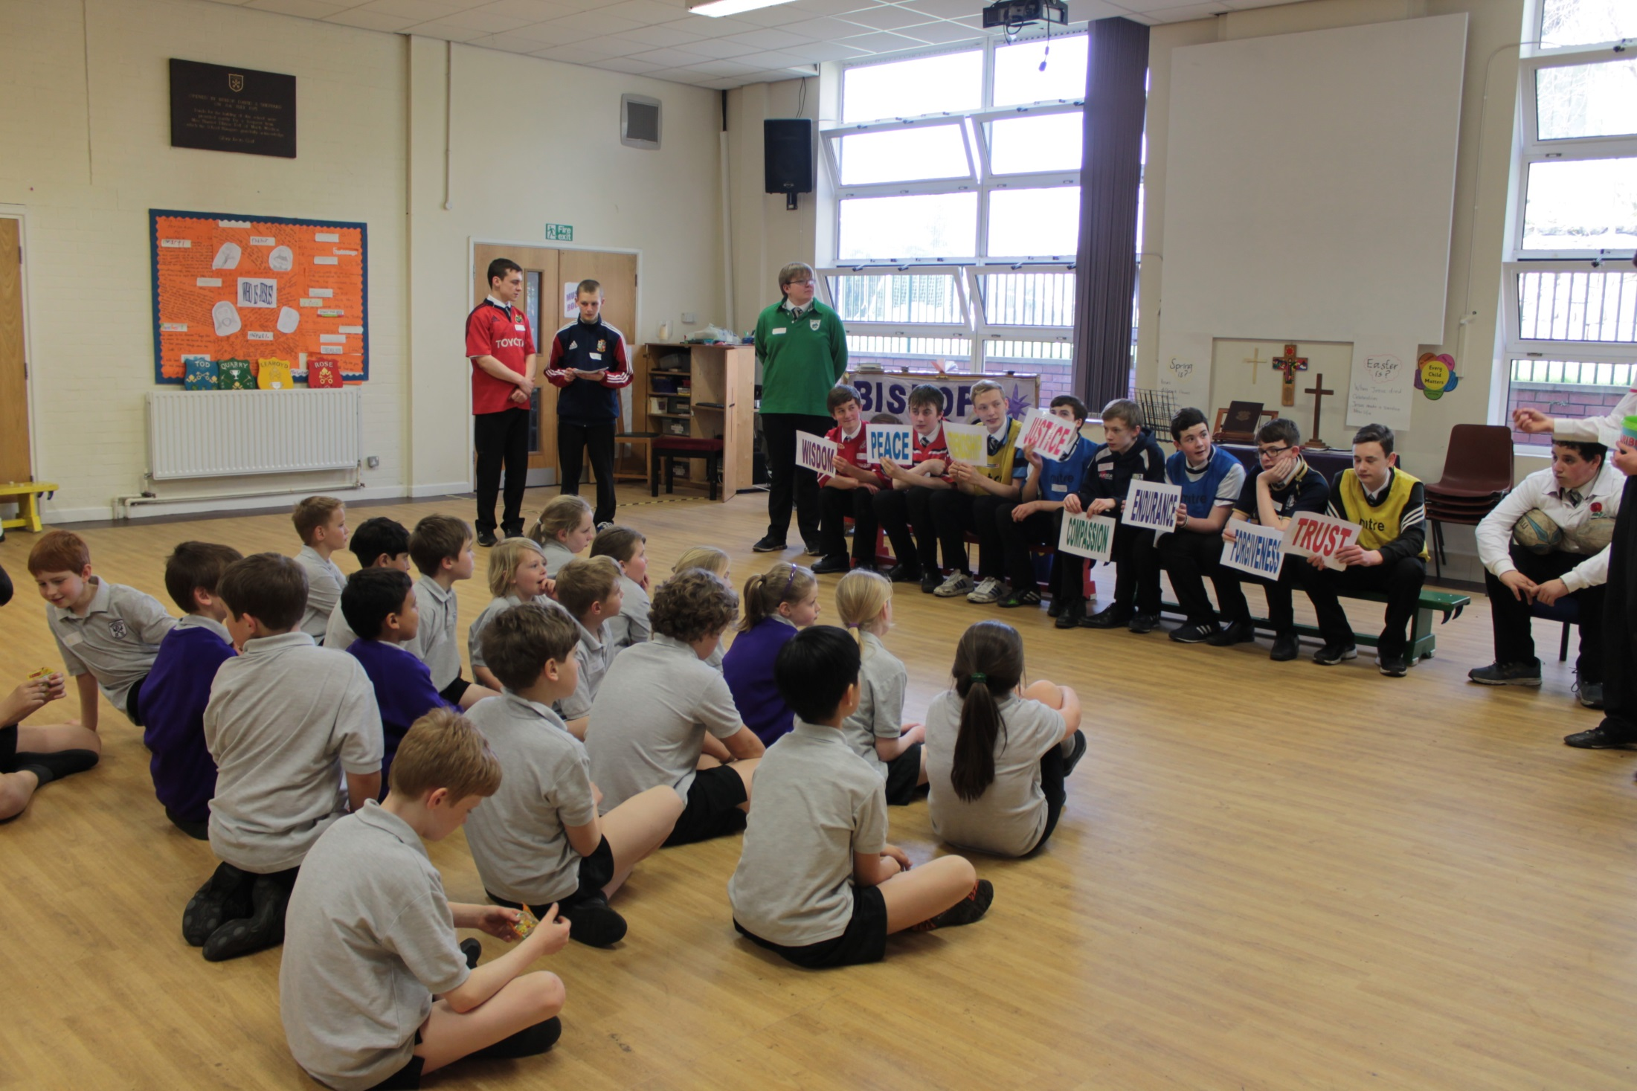

Slide 16
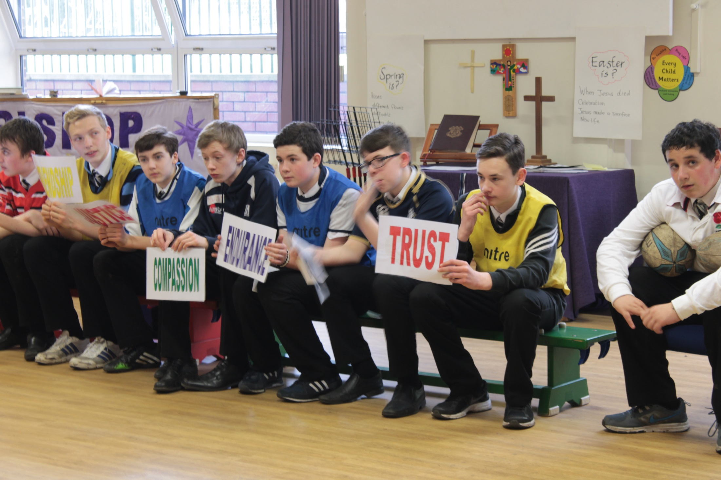

Slide 17
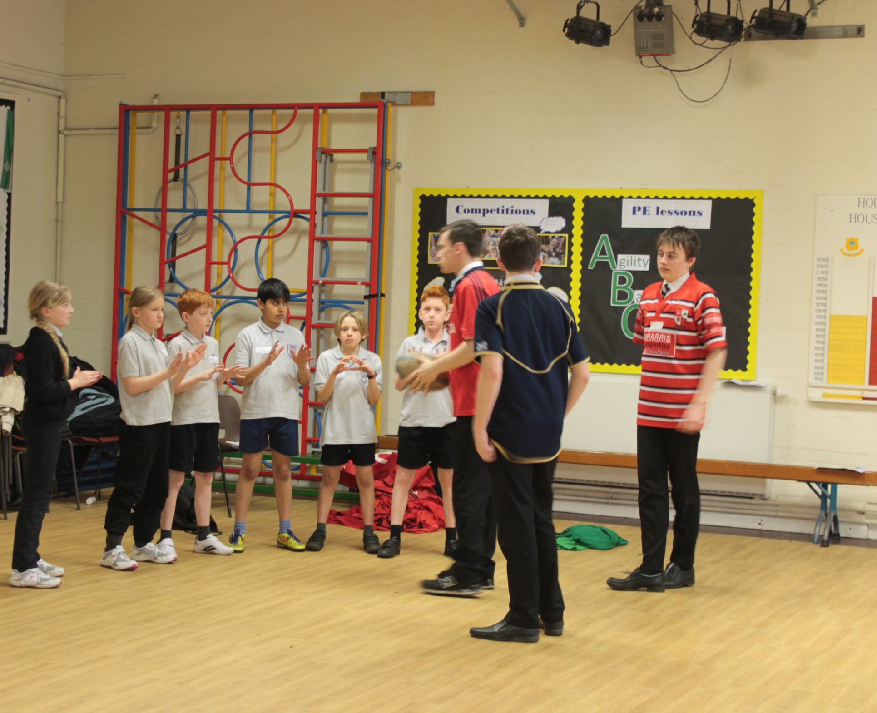
Wisdom

Slide 18
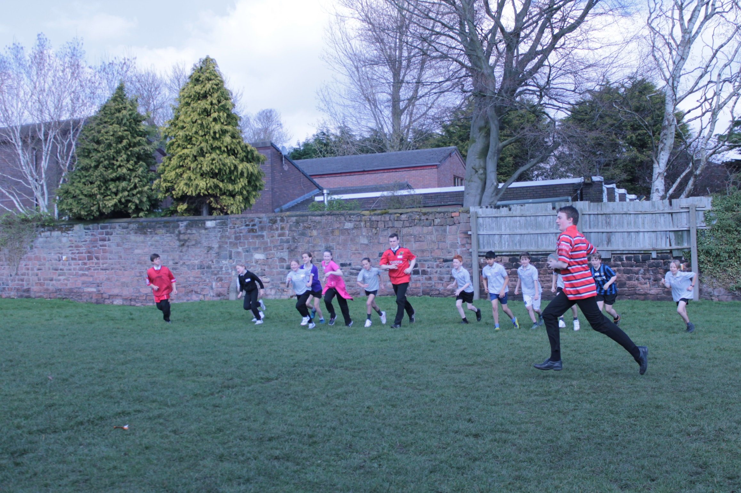
Endurance

Slide 19
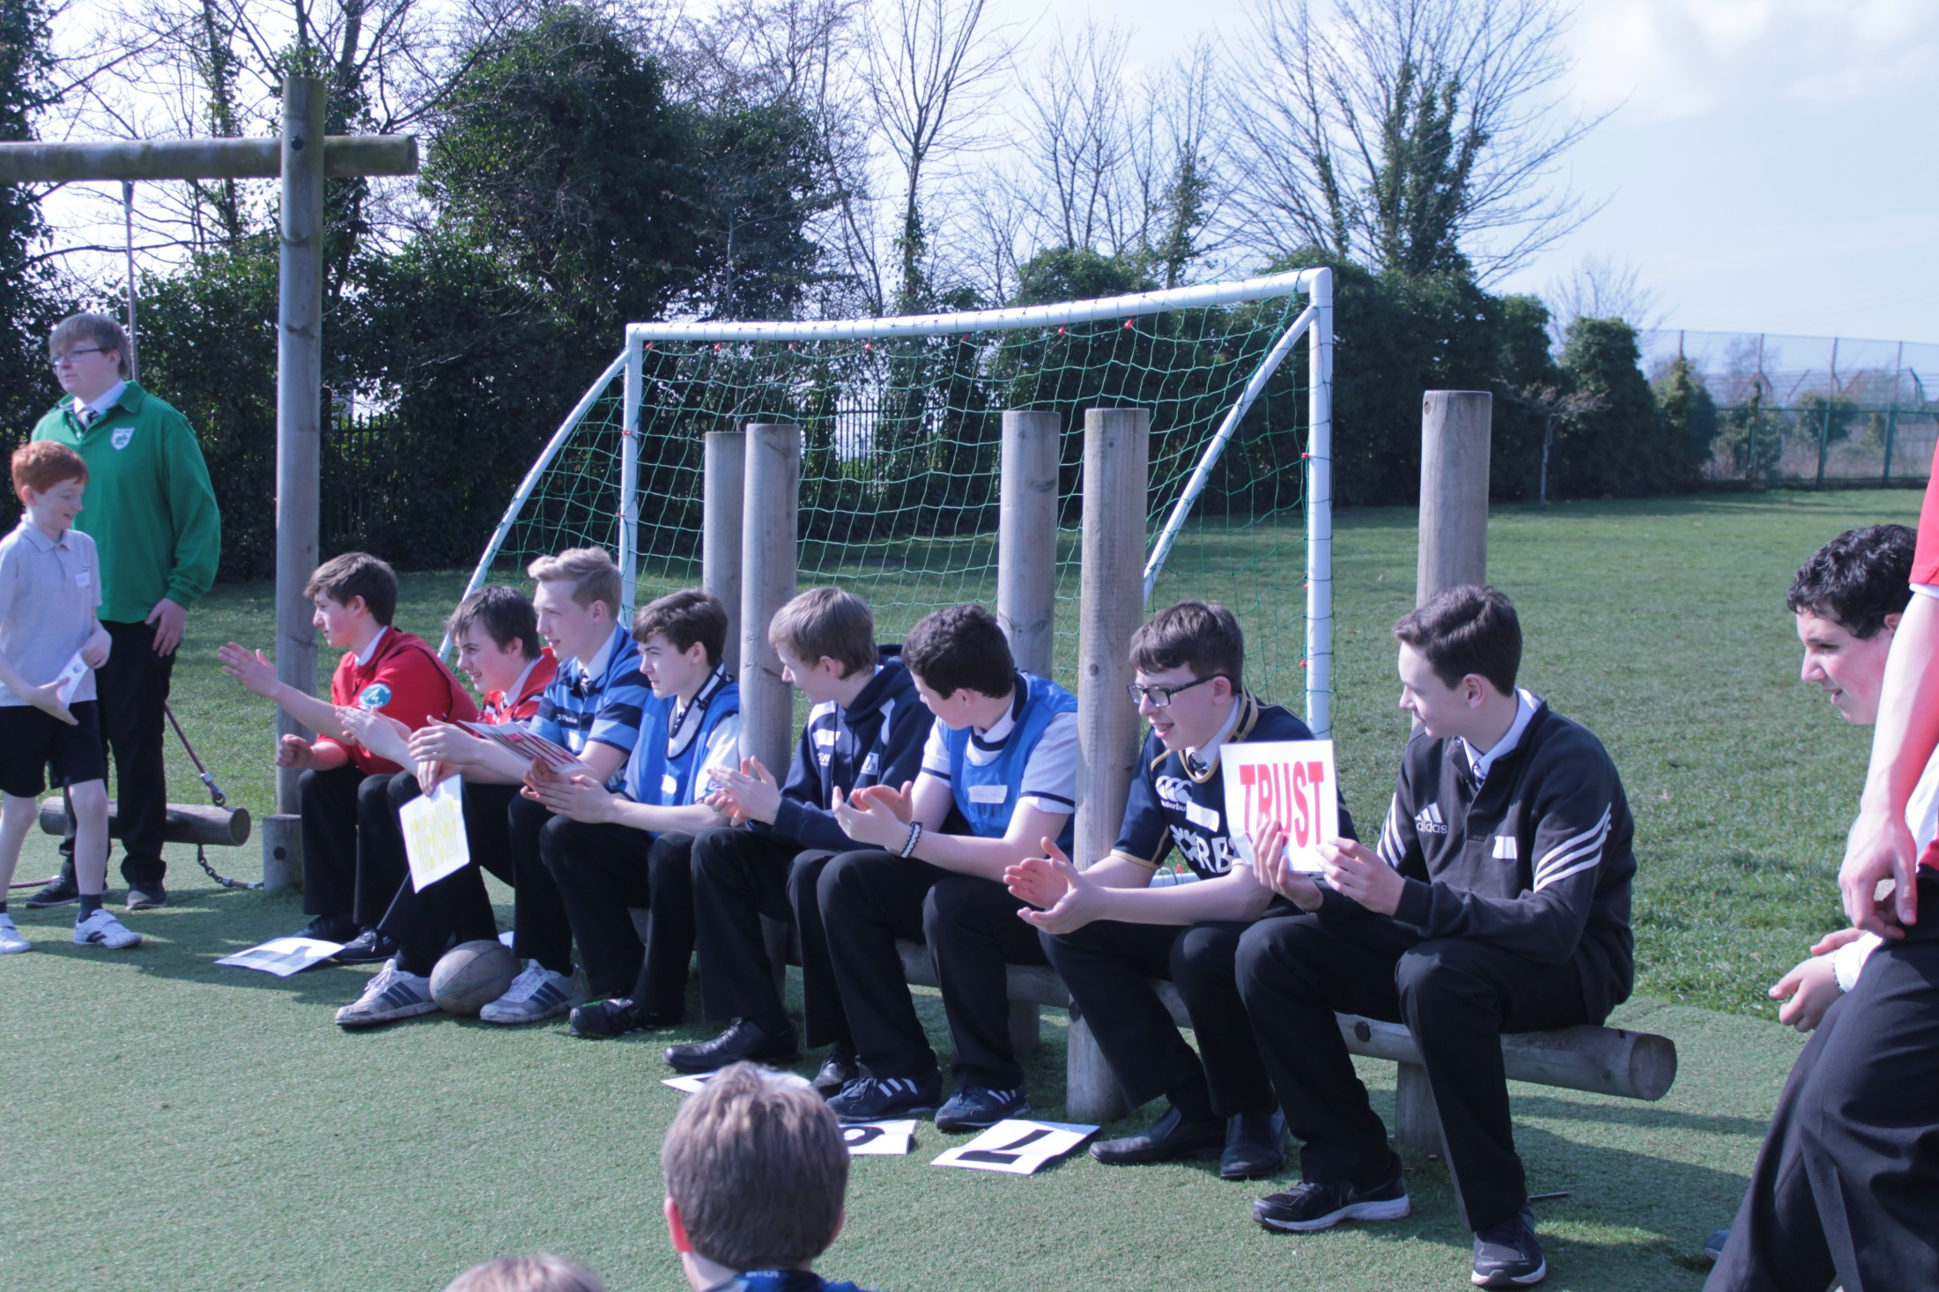

Slide 20
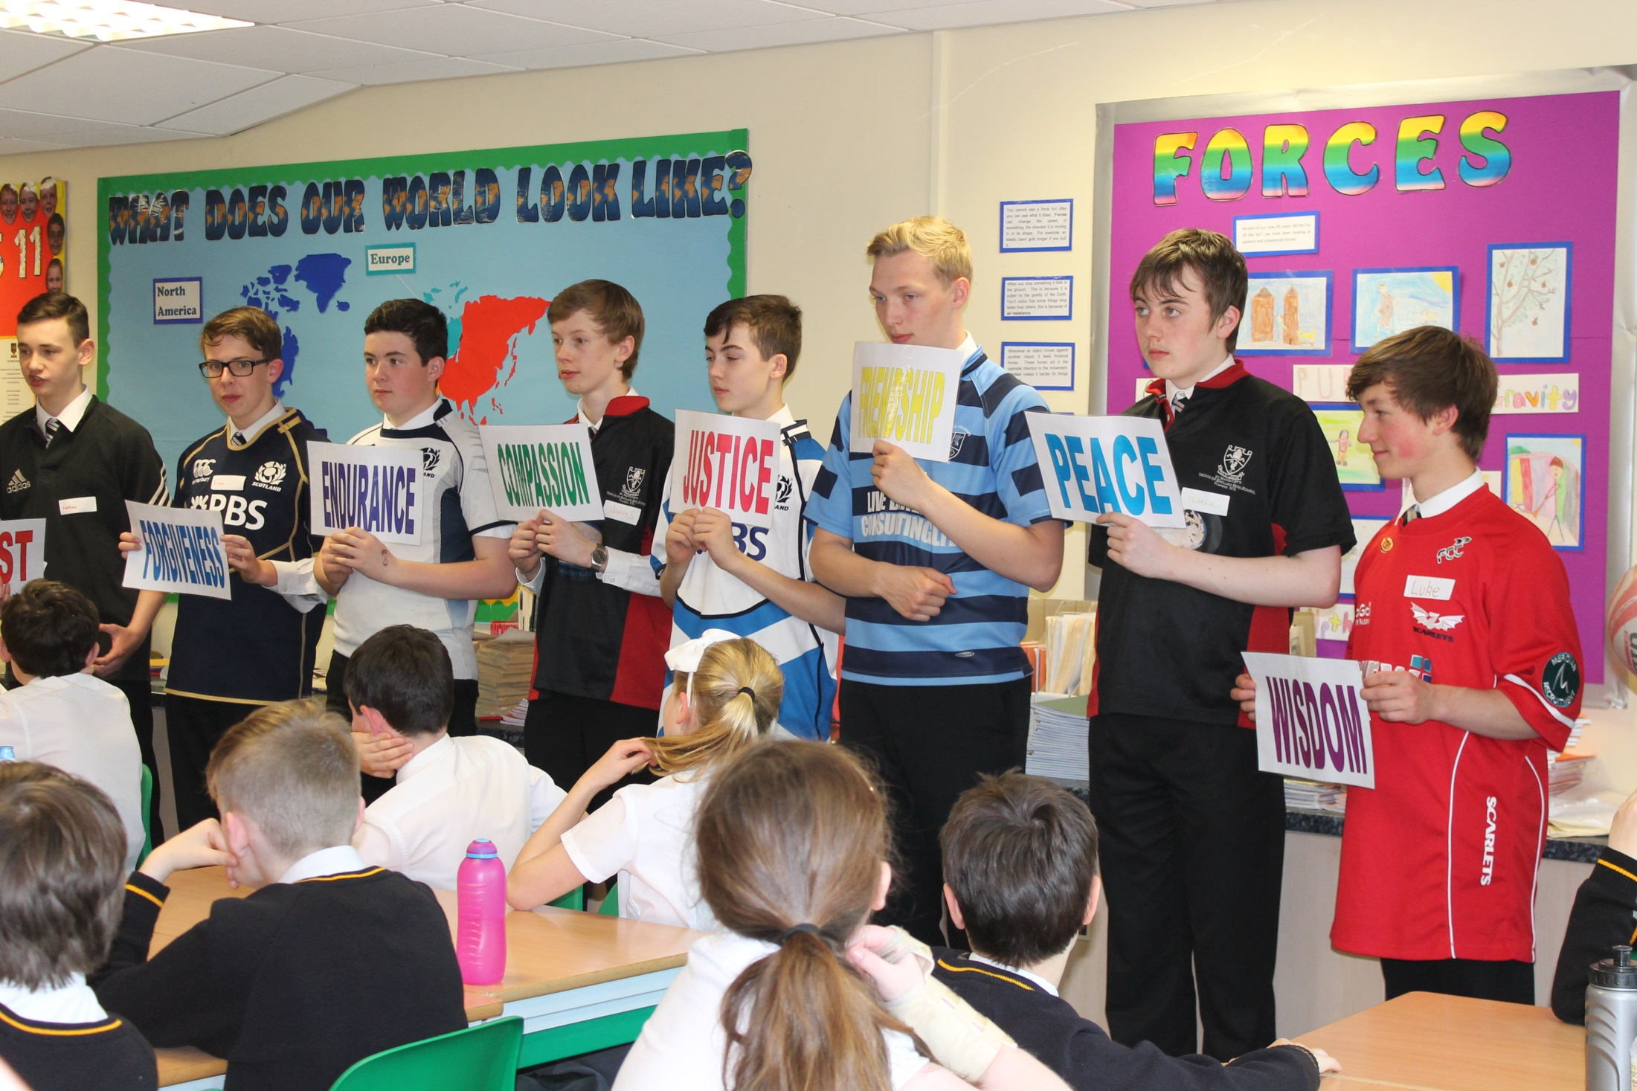

Slide 21
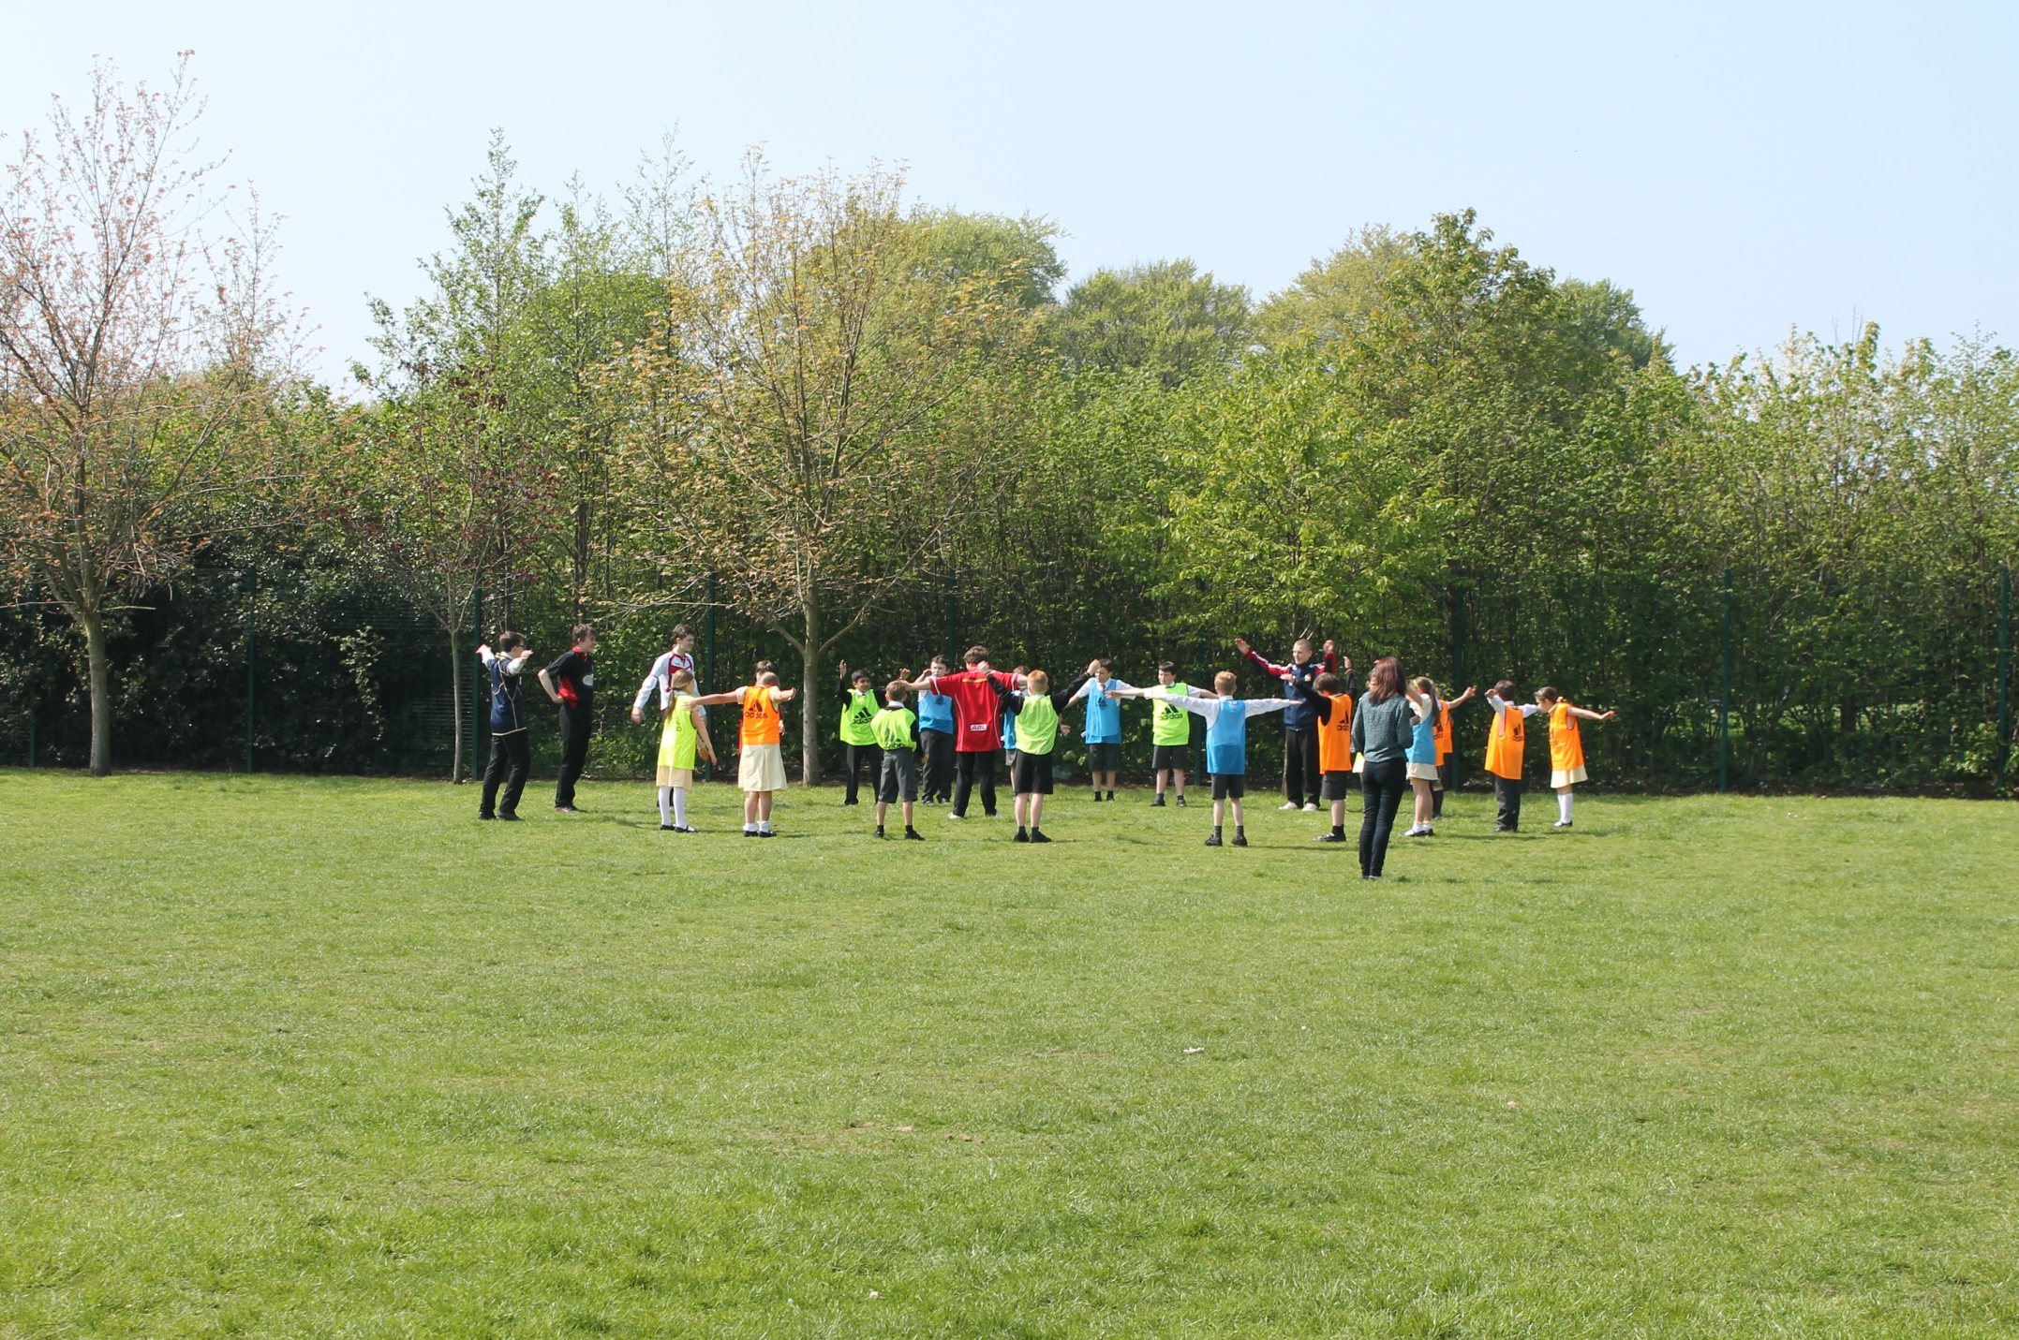

Slide 22
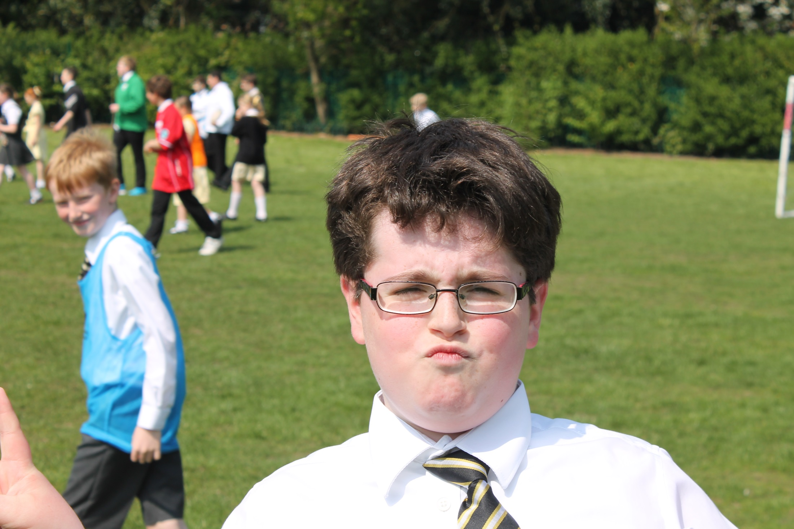
Confidence

Slide 23
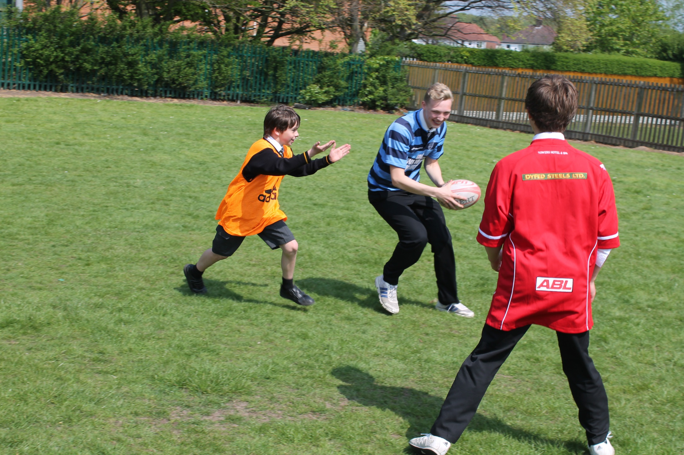
Wisdom

Slide 24
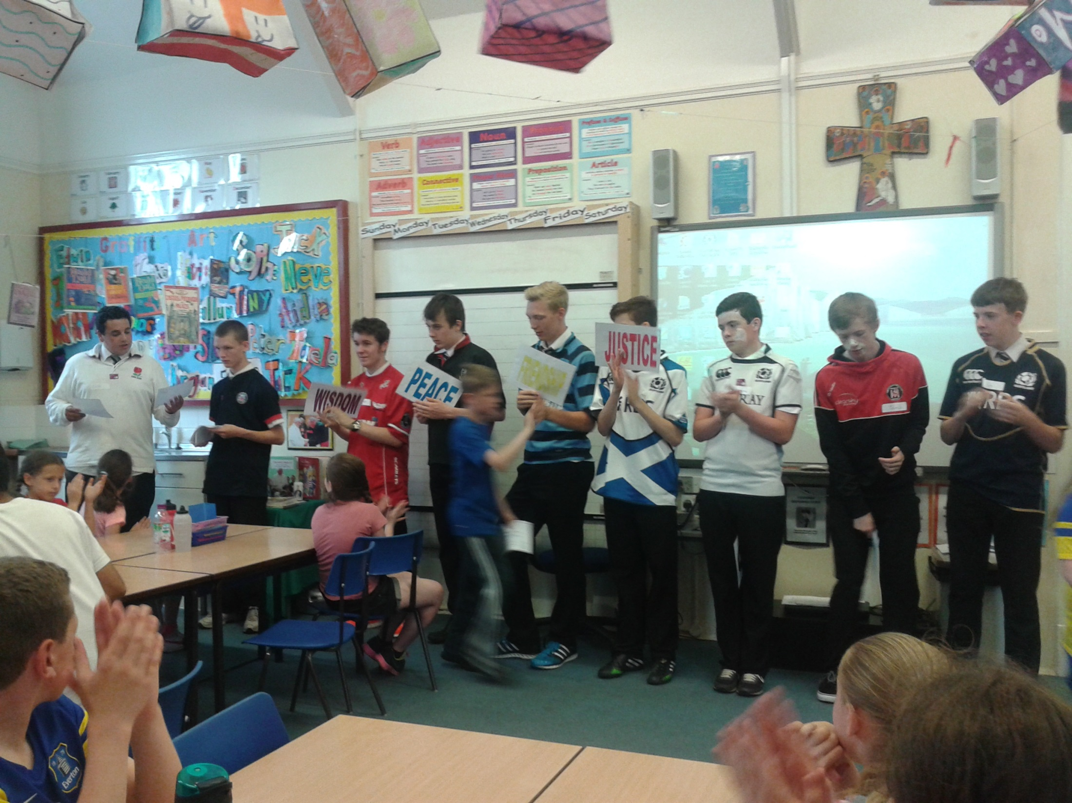

Slide 25
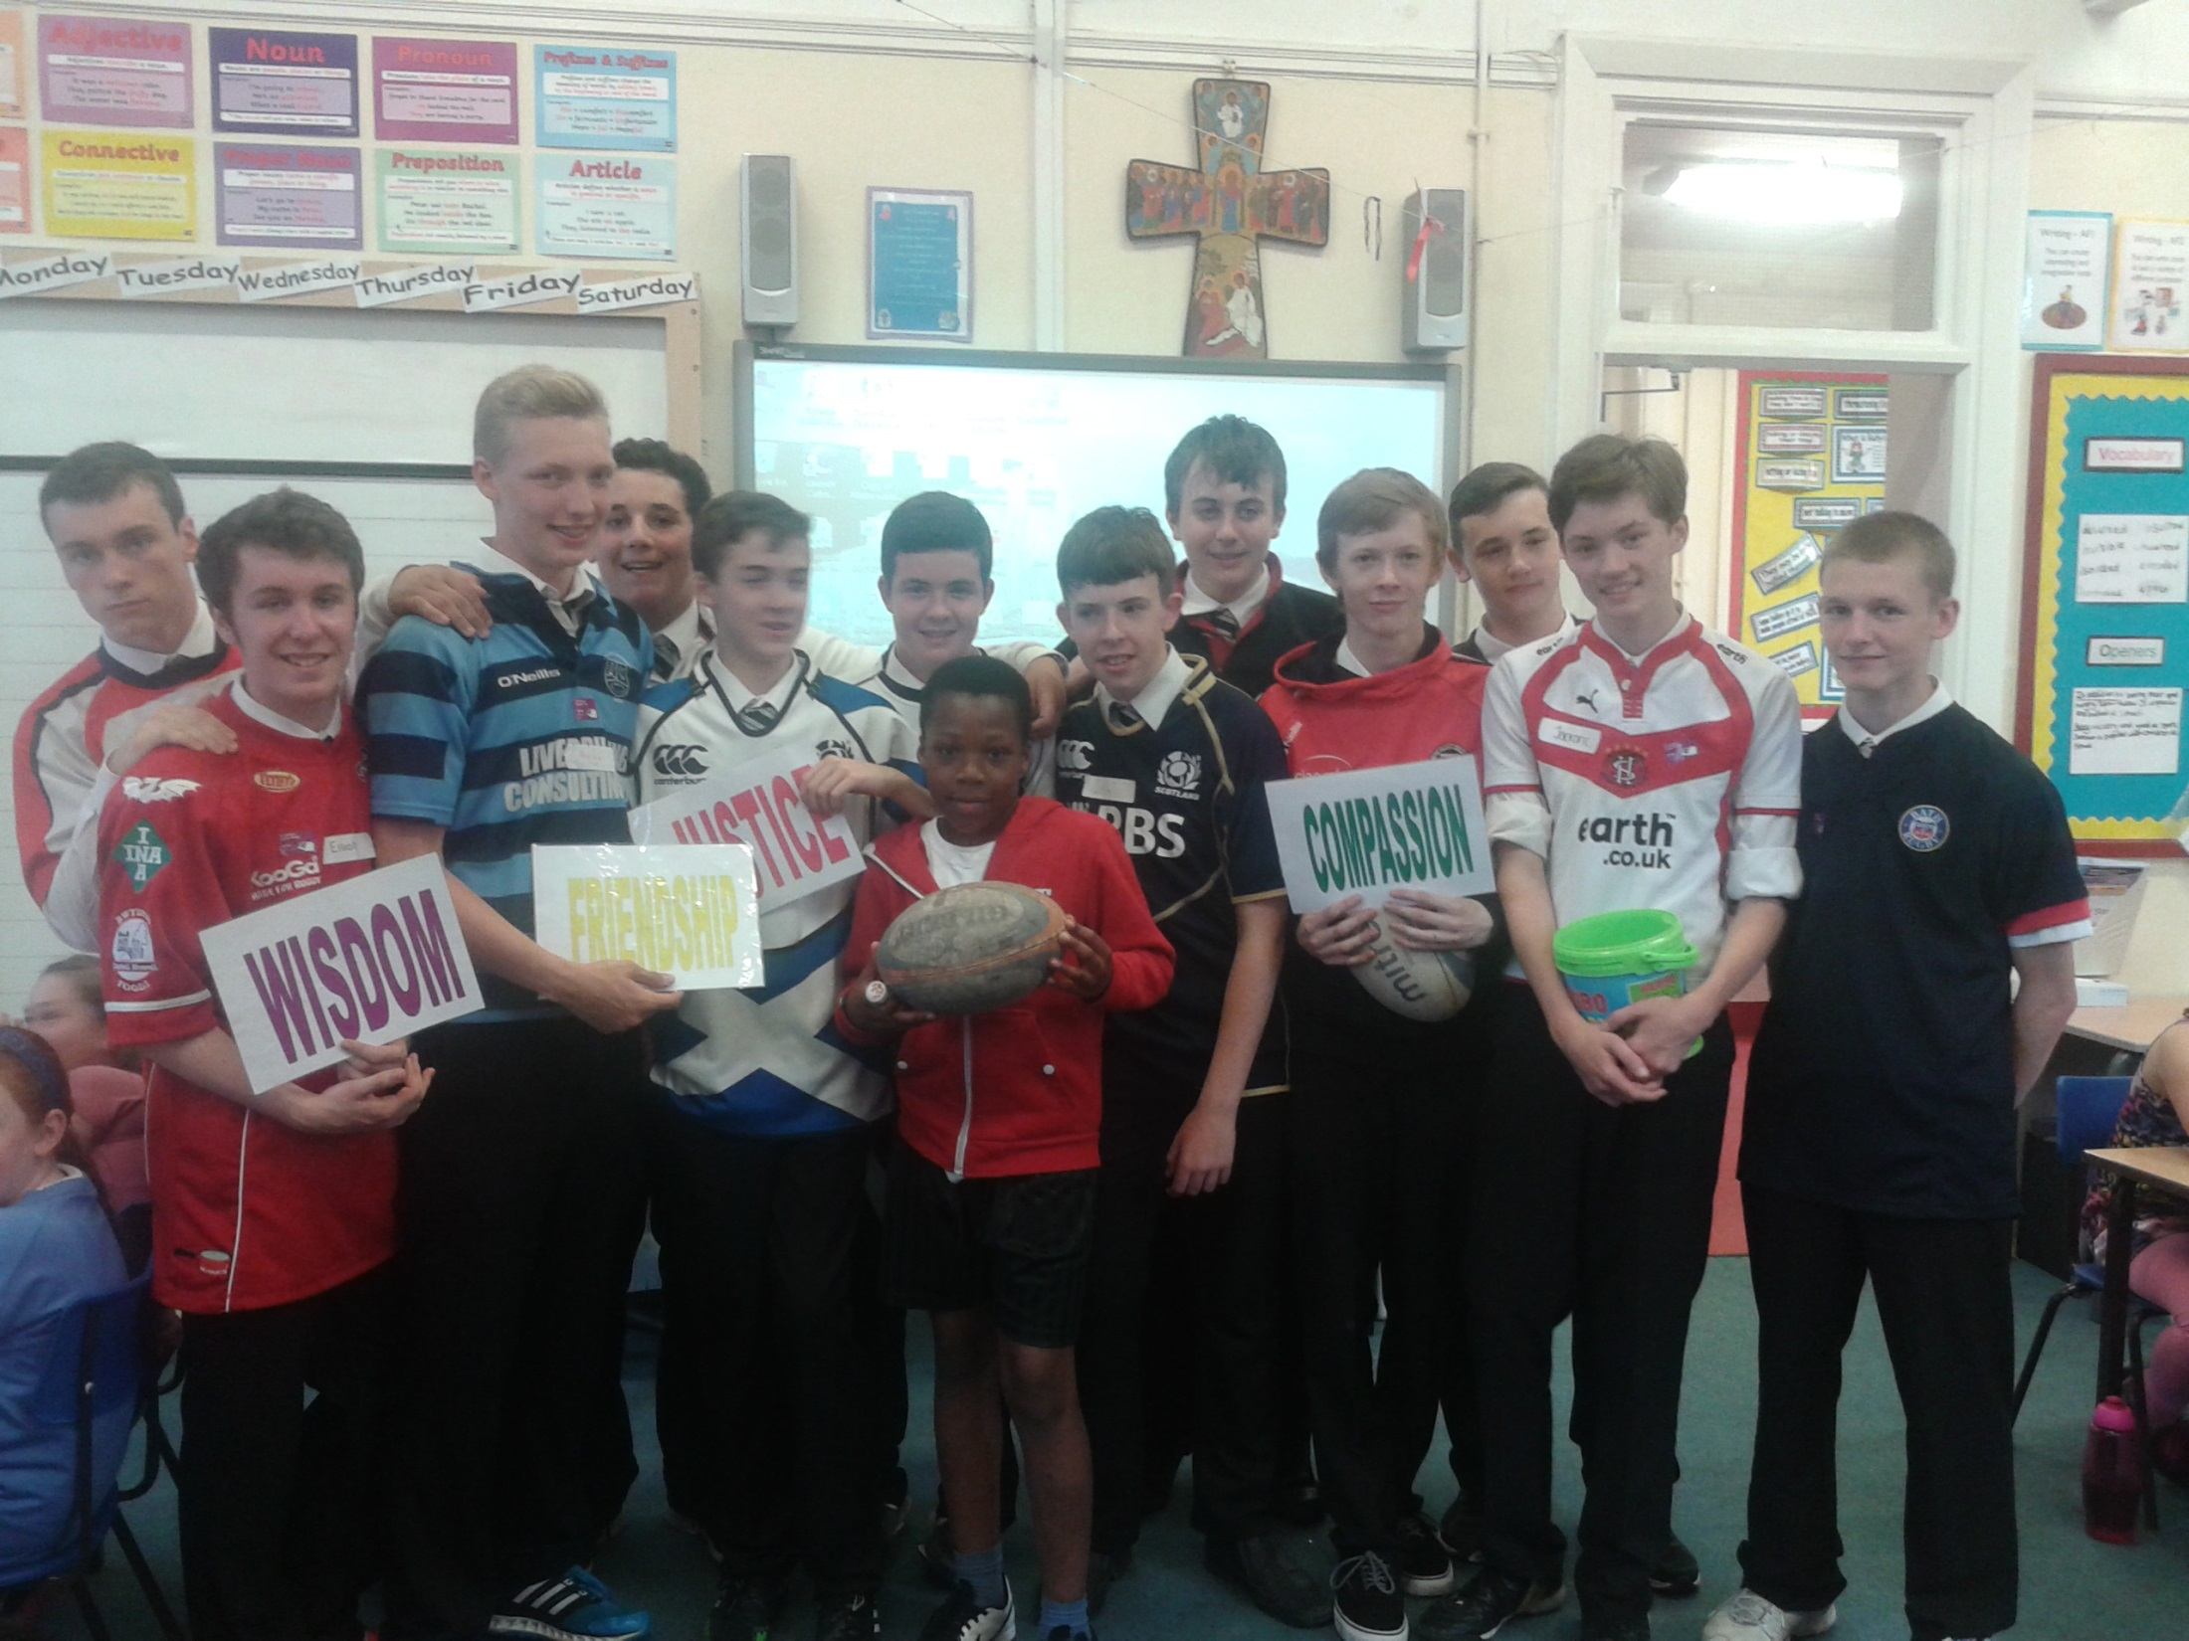
Justice

Slide 26
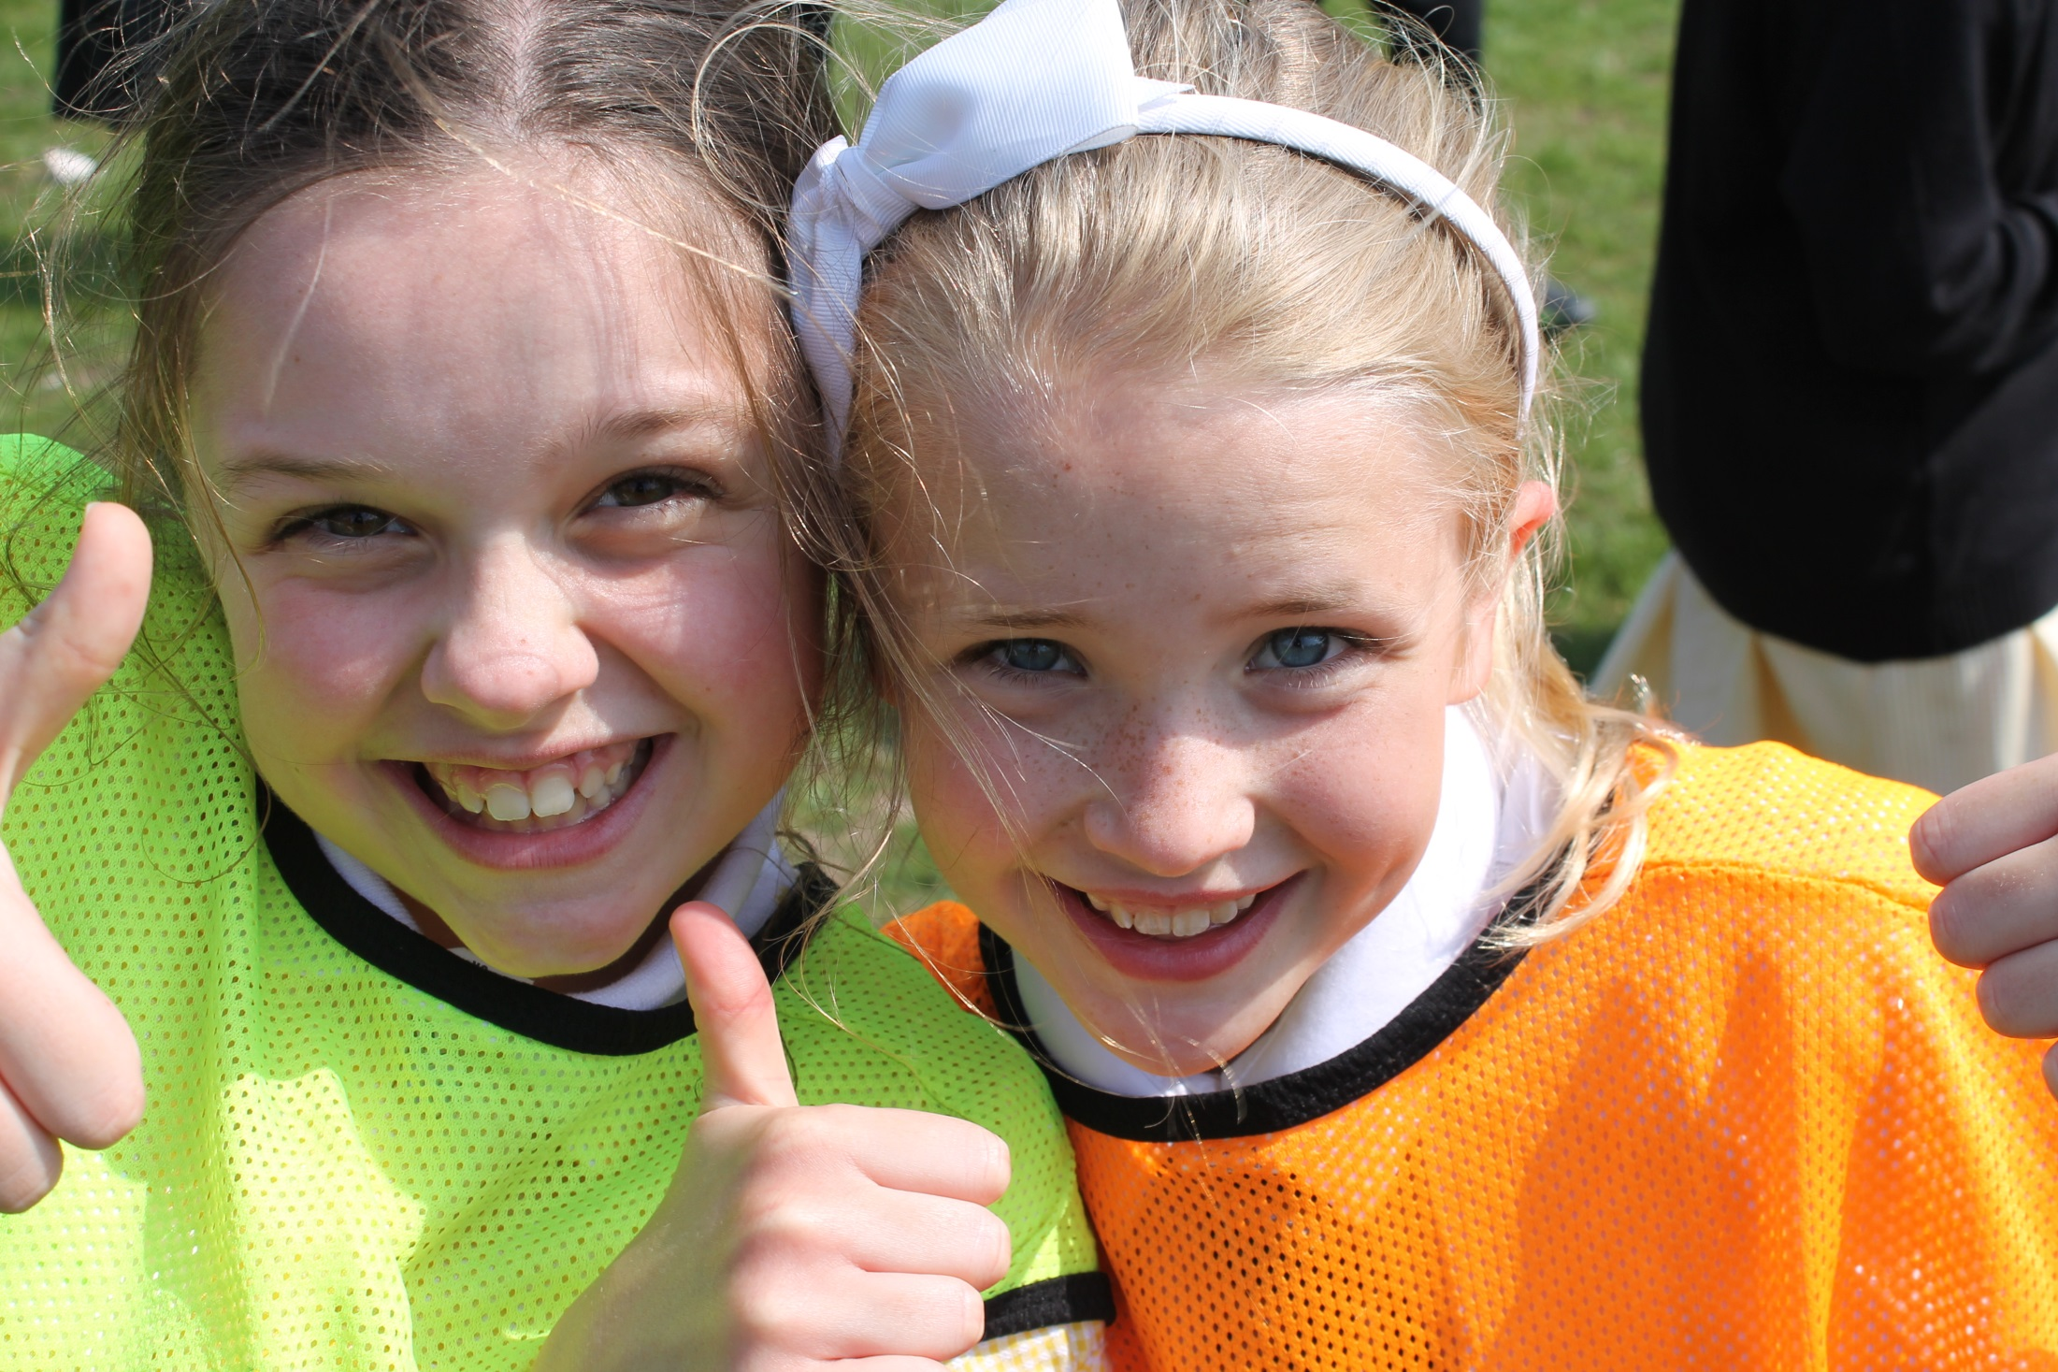
Friendship

Slide 27
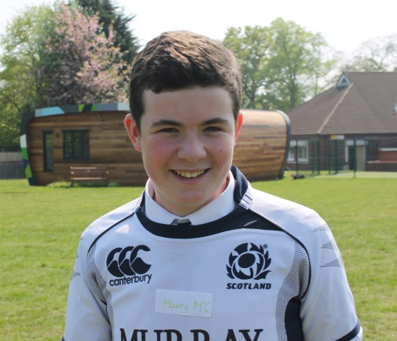
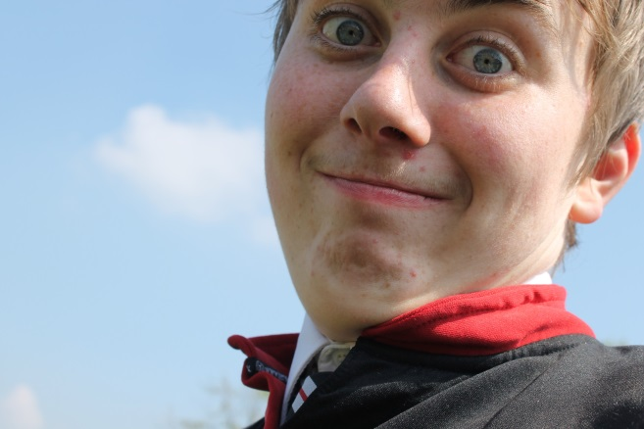
Matthew Hindley
Luke Hawkes
Max Gilroy
Harry McCarten
James Garnett
Liam Cato
Jamie Hazledine
Hugh Adams
James Ambler
Jack Gavin
Nathan Bowers
Eliot Smith
Nick Georgiou
Jamie Samuels

Slide 28
Many thanks to these Year 11’s who did a tremendous job in some of our feeder primary schools.
They are OUTSTANDING ambassadors for our school.
Good men themselves!

