Slide 1
Active Adventures
Year 11 reward day

Slide 2
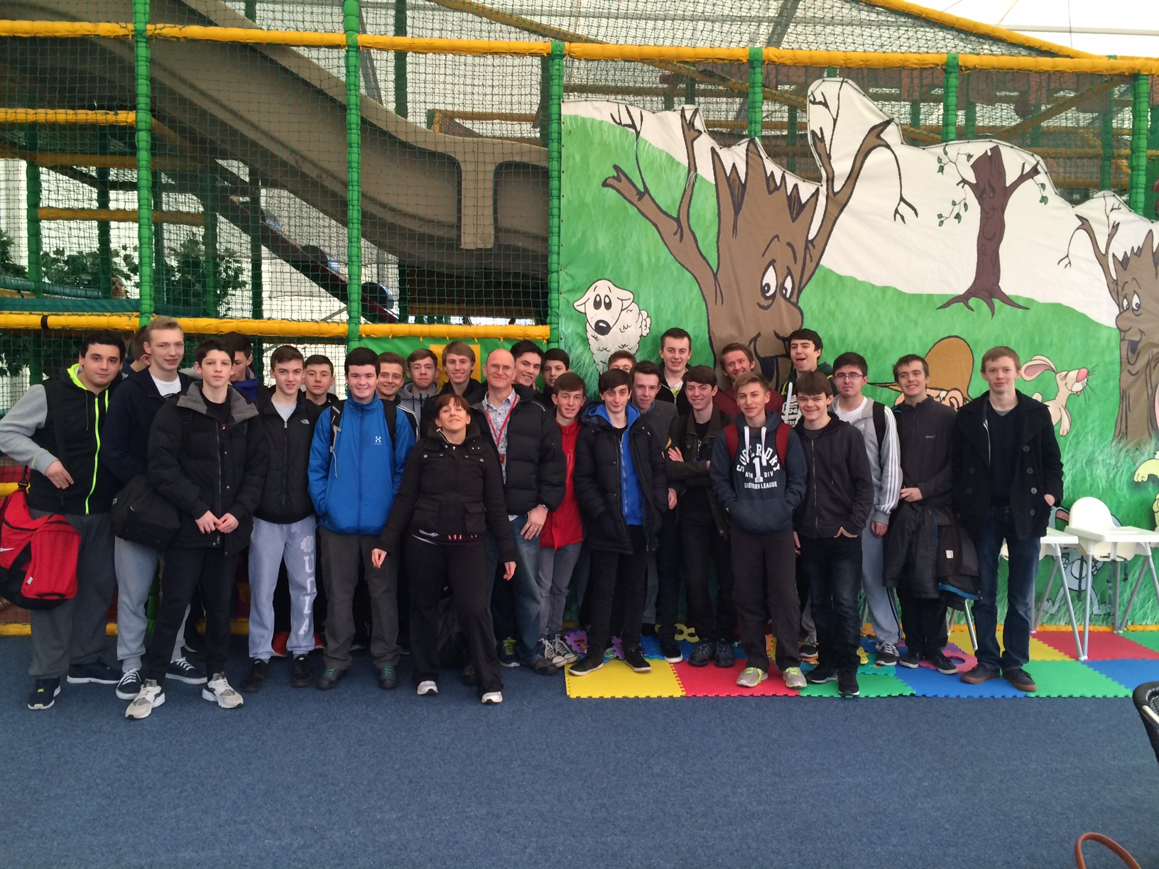
Active Adventures
Thank you for all your
hard work over the last year
Miss Kinloch and Mr Lightfoot
Year 11 rewards day for GOLD Volunteering achievement

Slide 3
Our School Values;
Trust
Compassion
Forgiveness
Endurance
Justice
Friendship
Peace
Wisdom

Slide 4
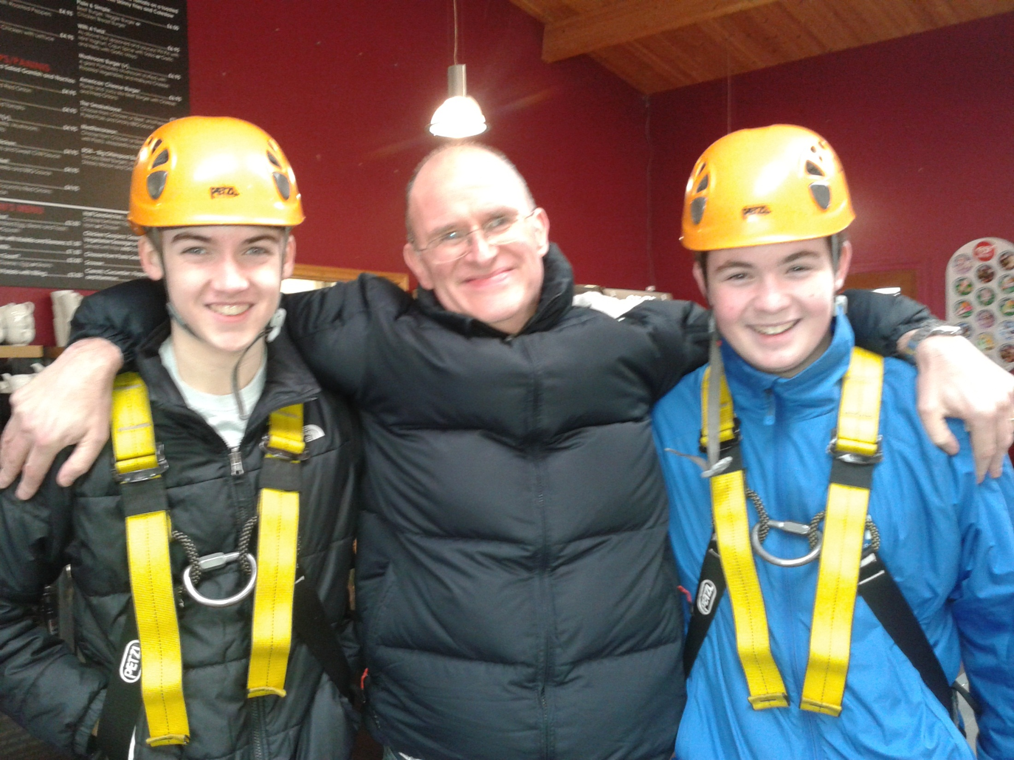
Wisdom

Slide 5
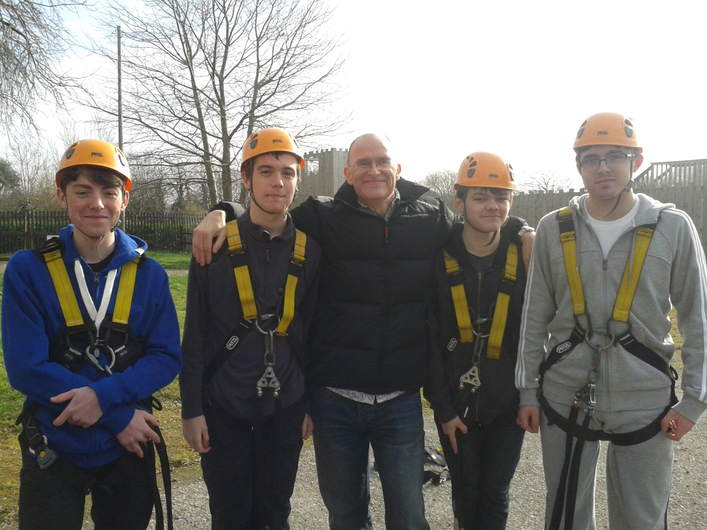
Wisdom

Slide 6
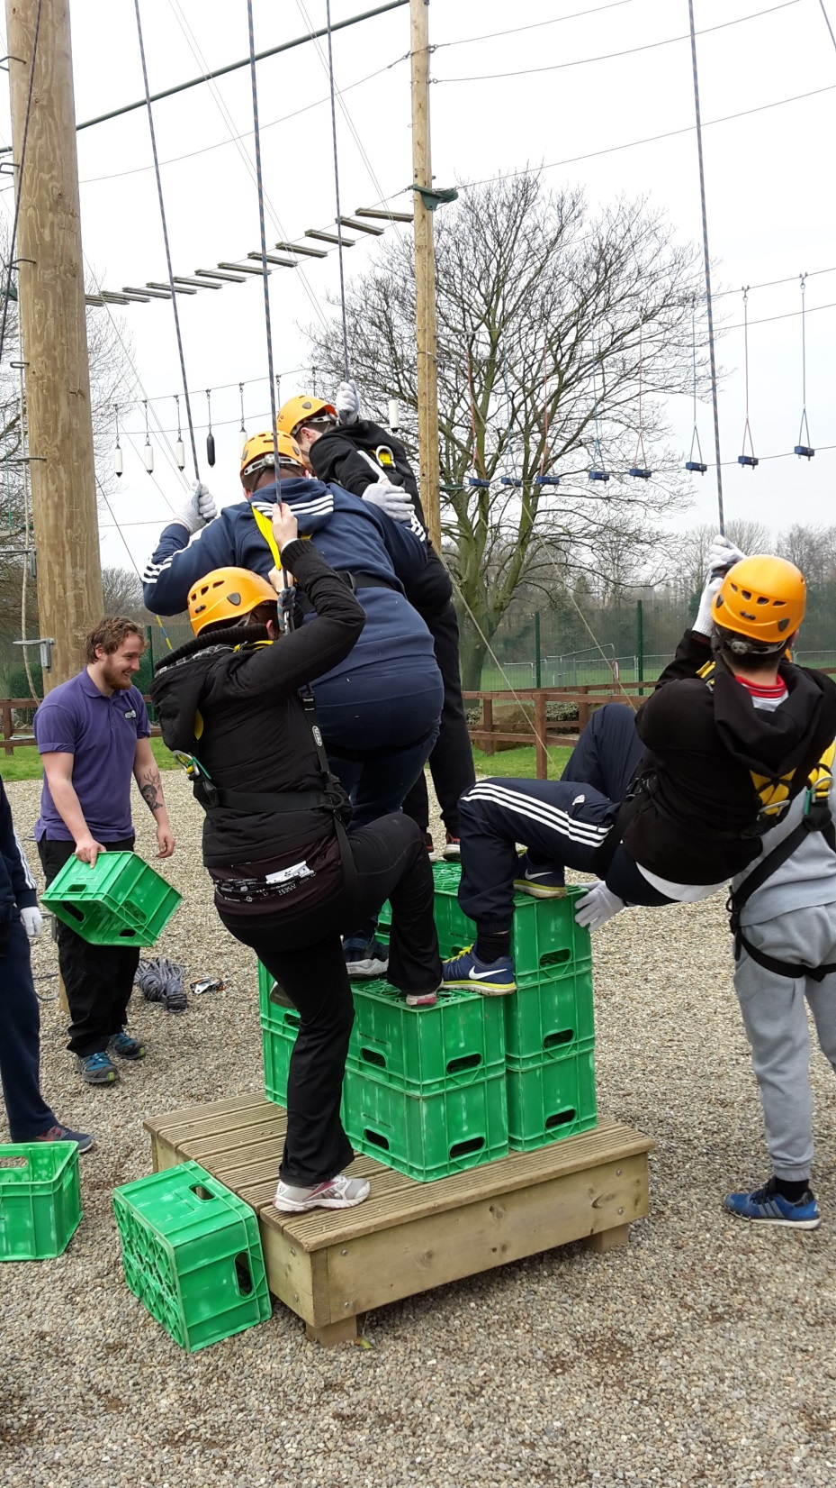
Trust

Slide 7
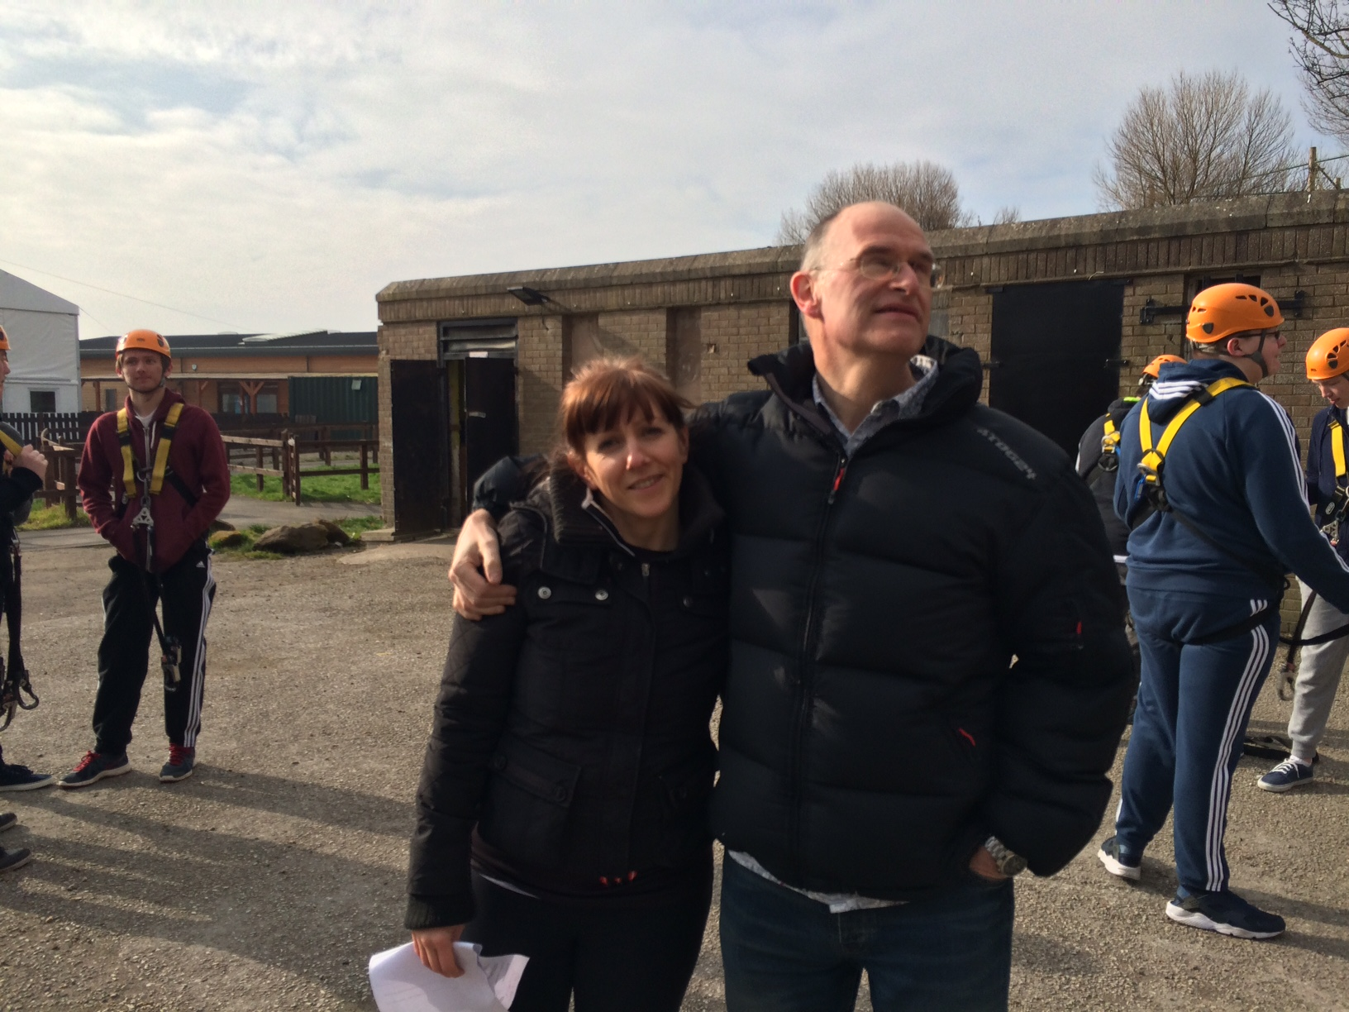
Endurance

Slide 8
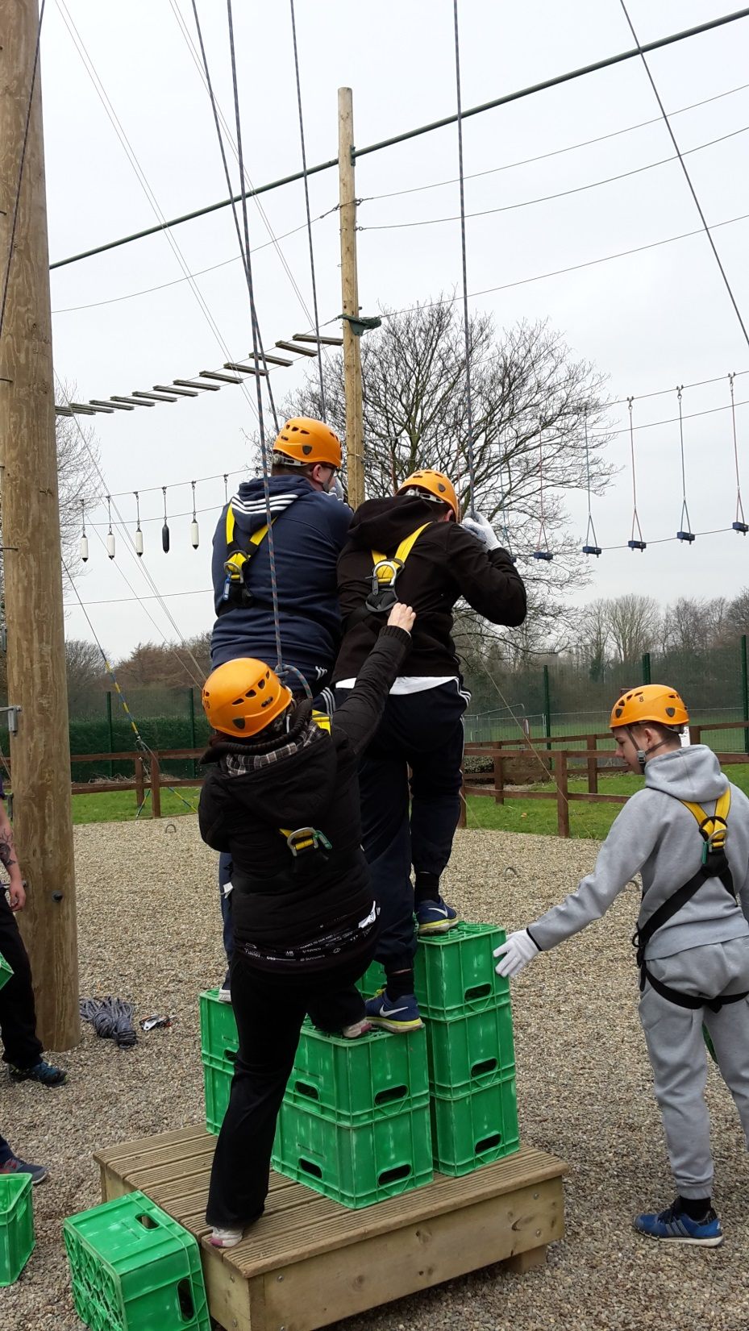
Friendship

Slide 9
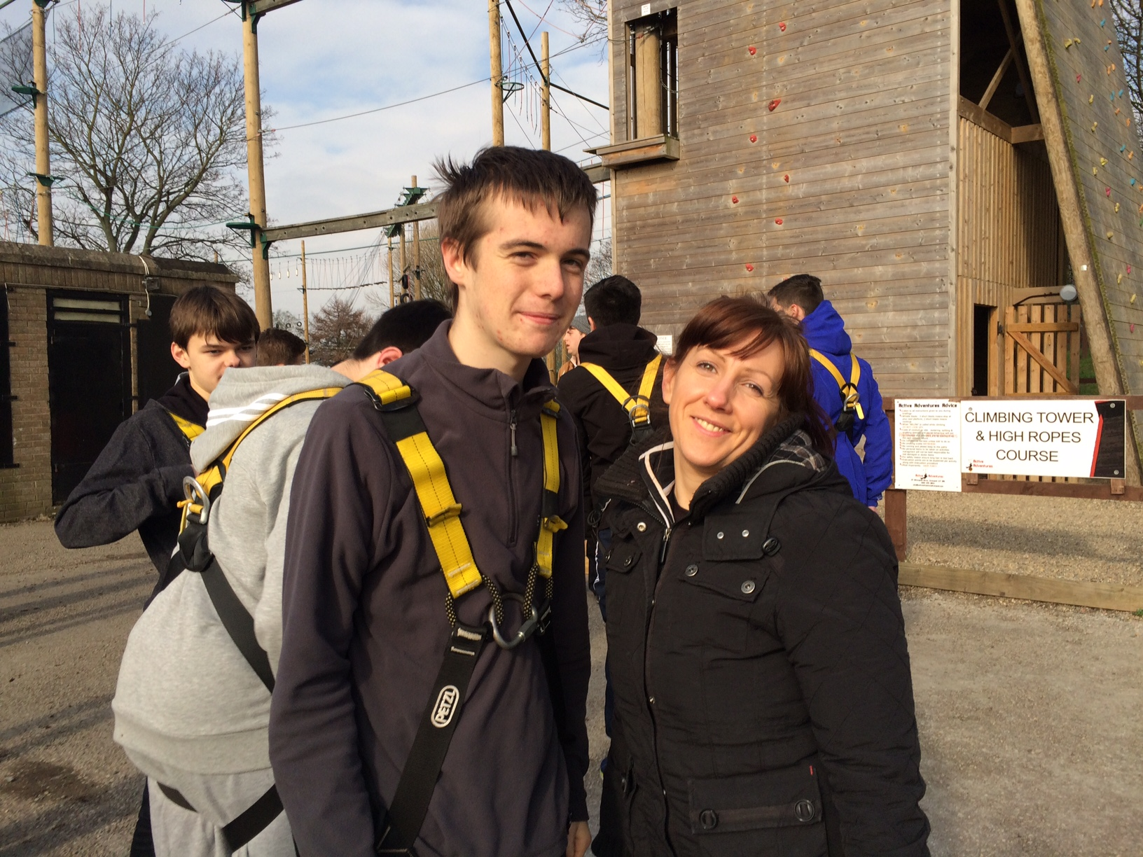
Wisdom

Slide 10
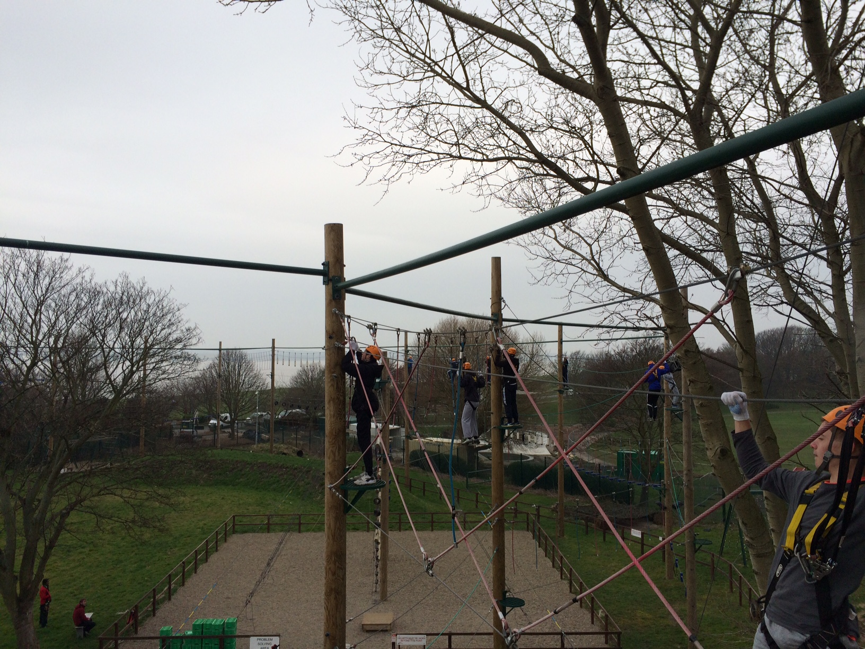
Wisdom

Slide 11
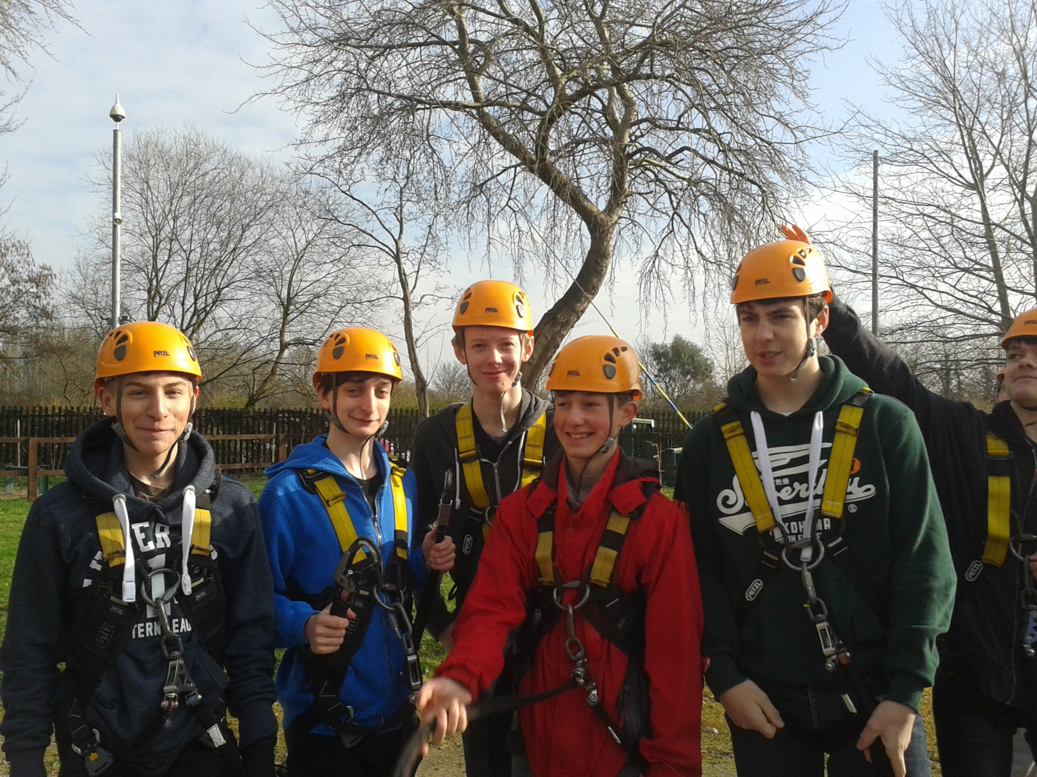
Friendship

Slide 12
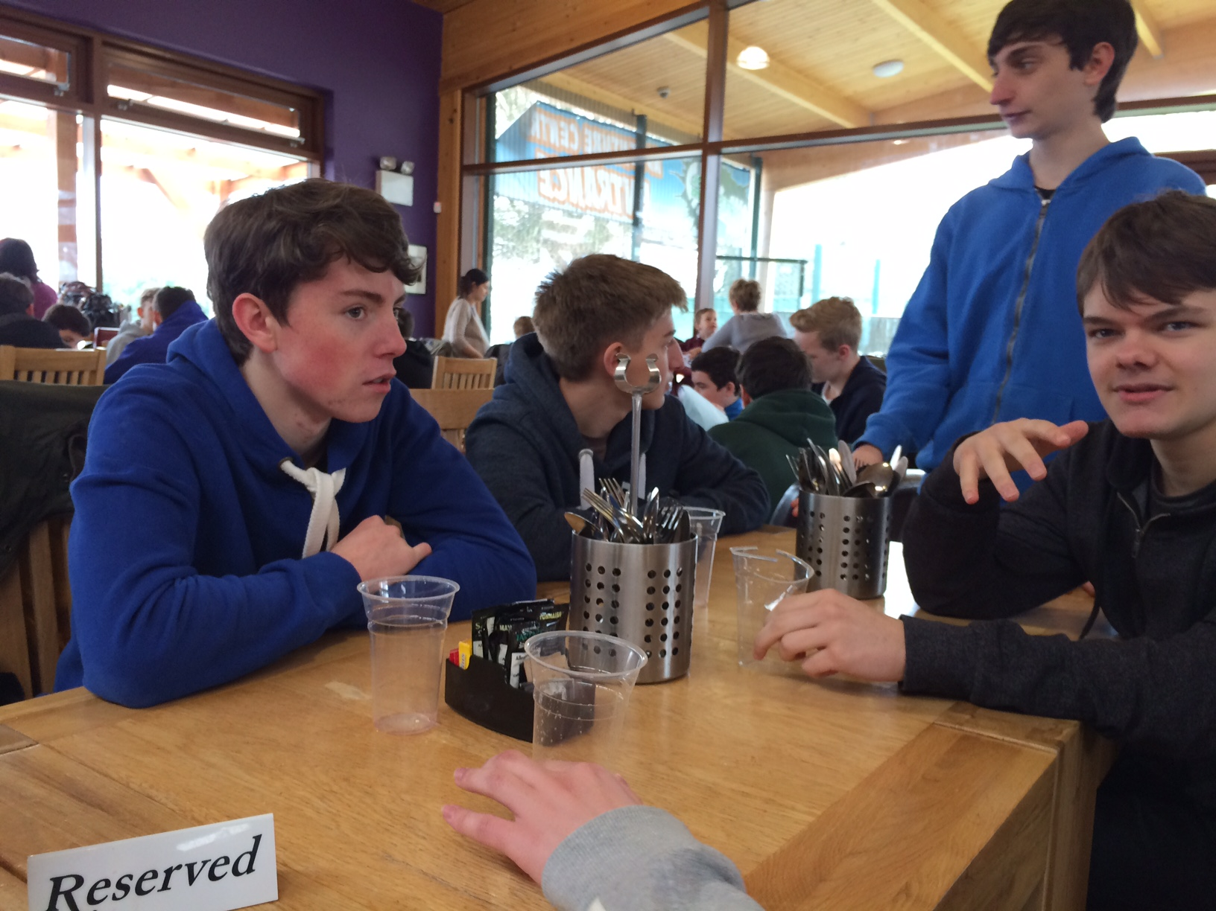
Friendship

Slide 13
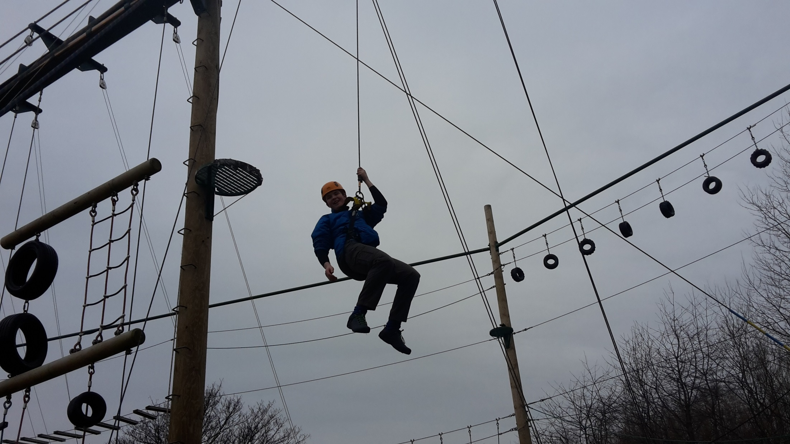
Trust

Slide 14
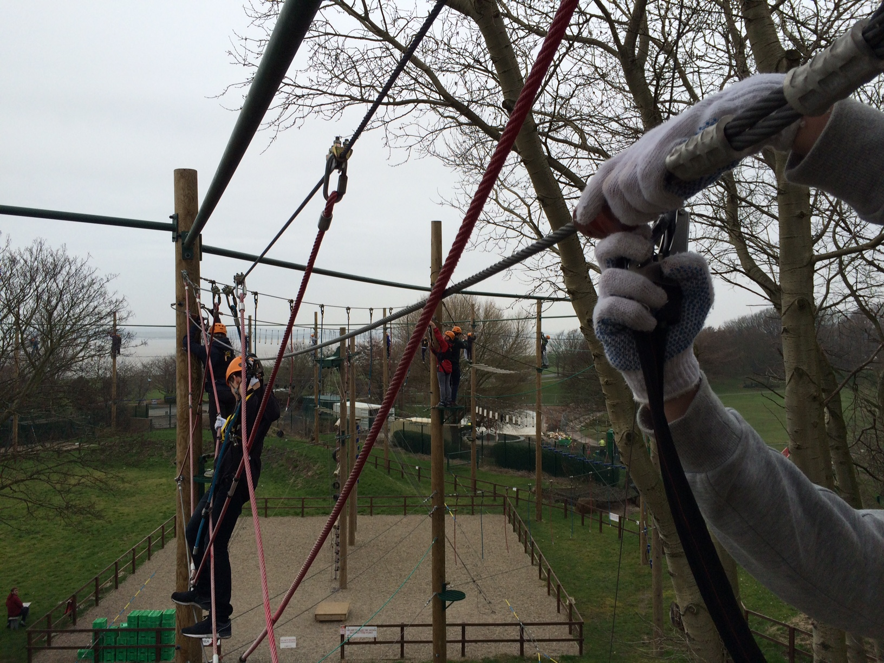
Endurance

Slide 15
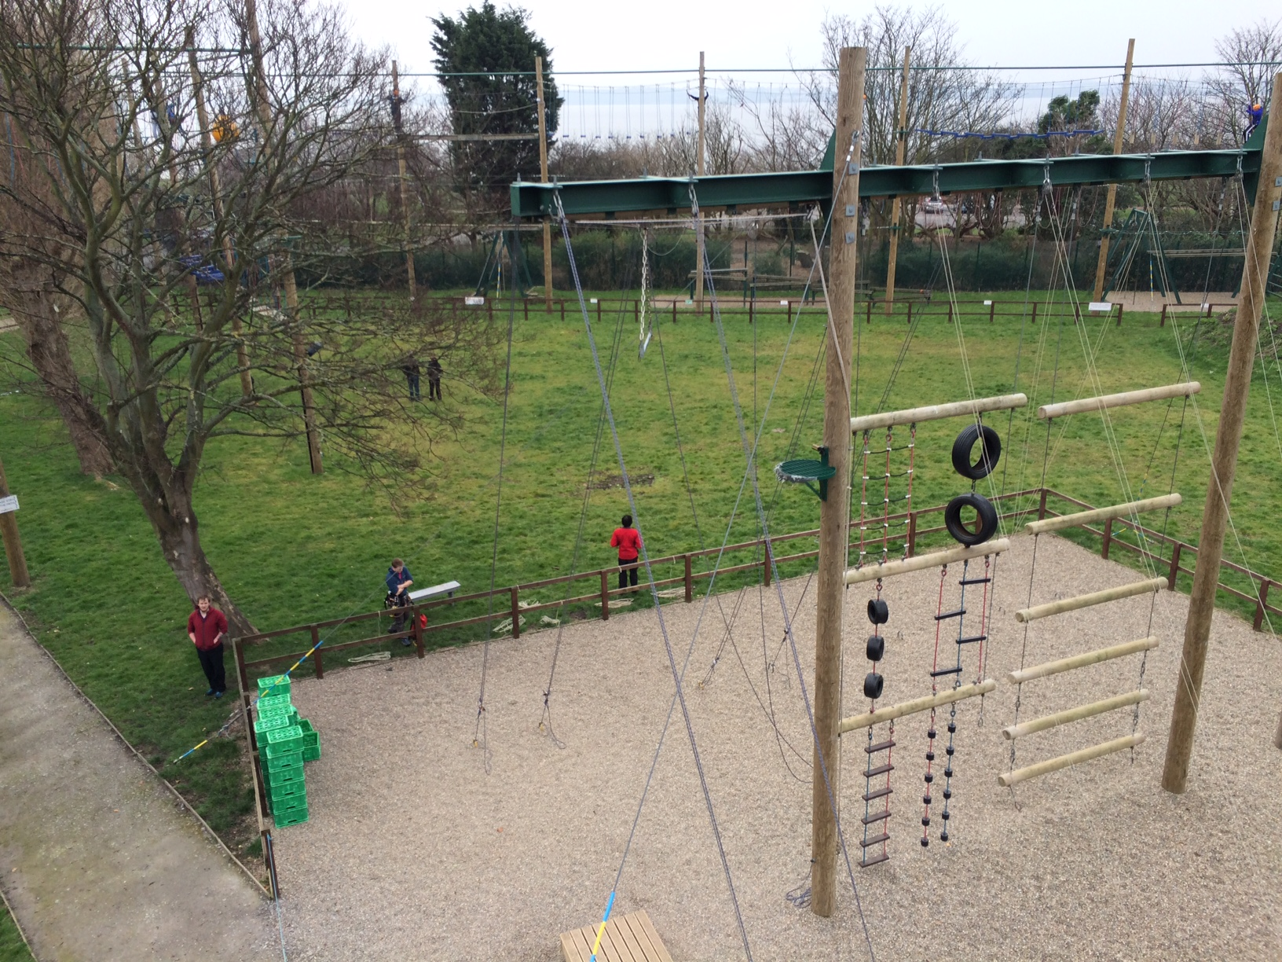
Wisdom

Slide 16
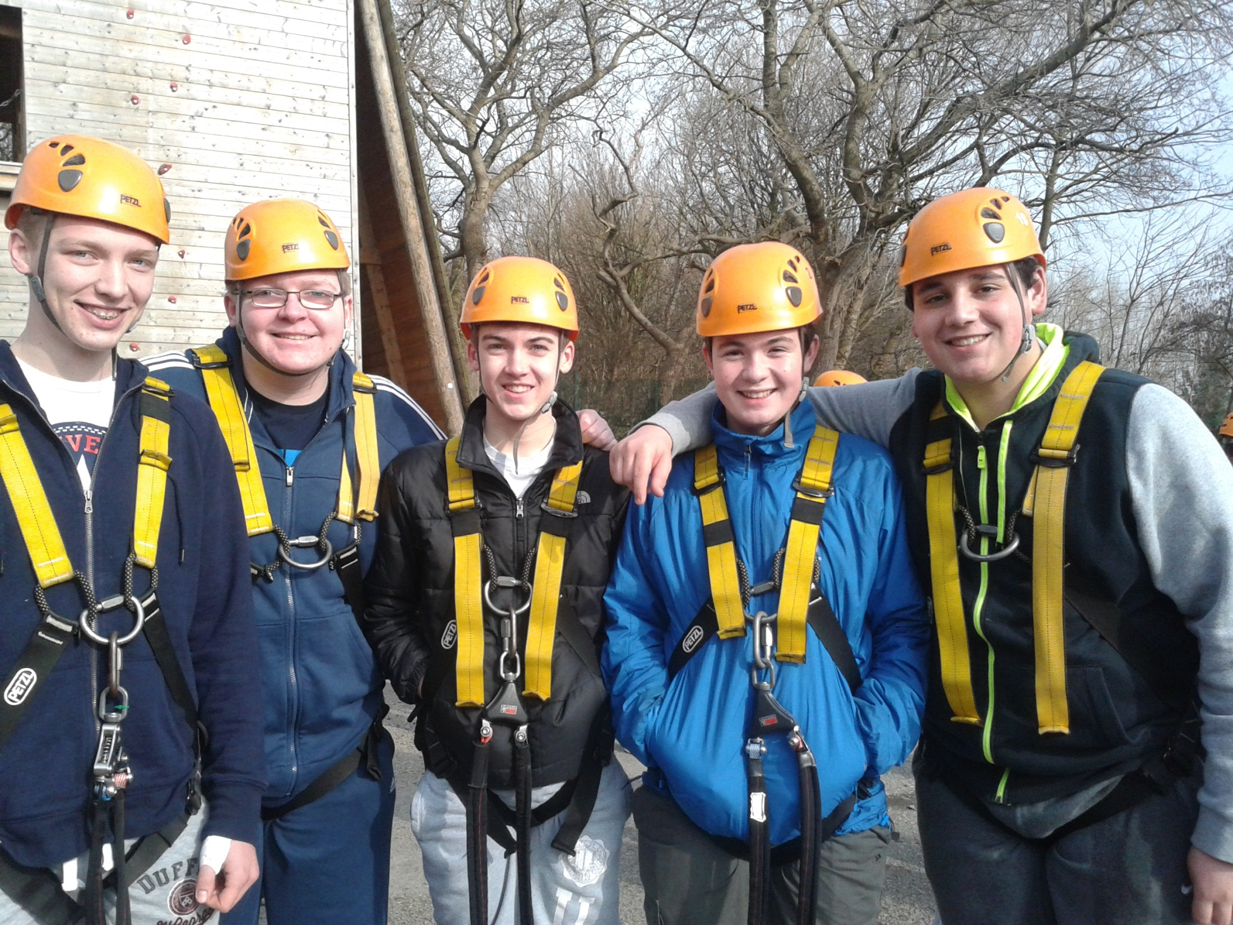
Wisdom

Slide 17
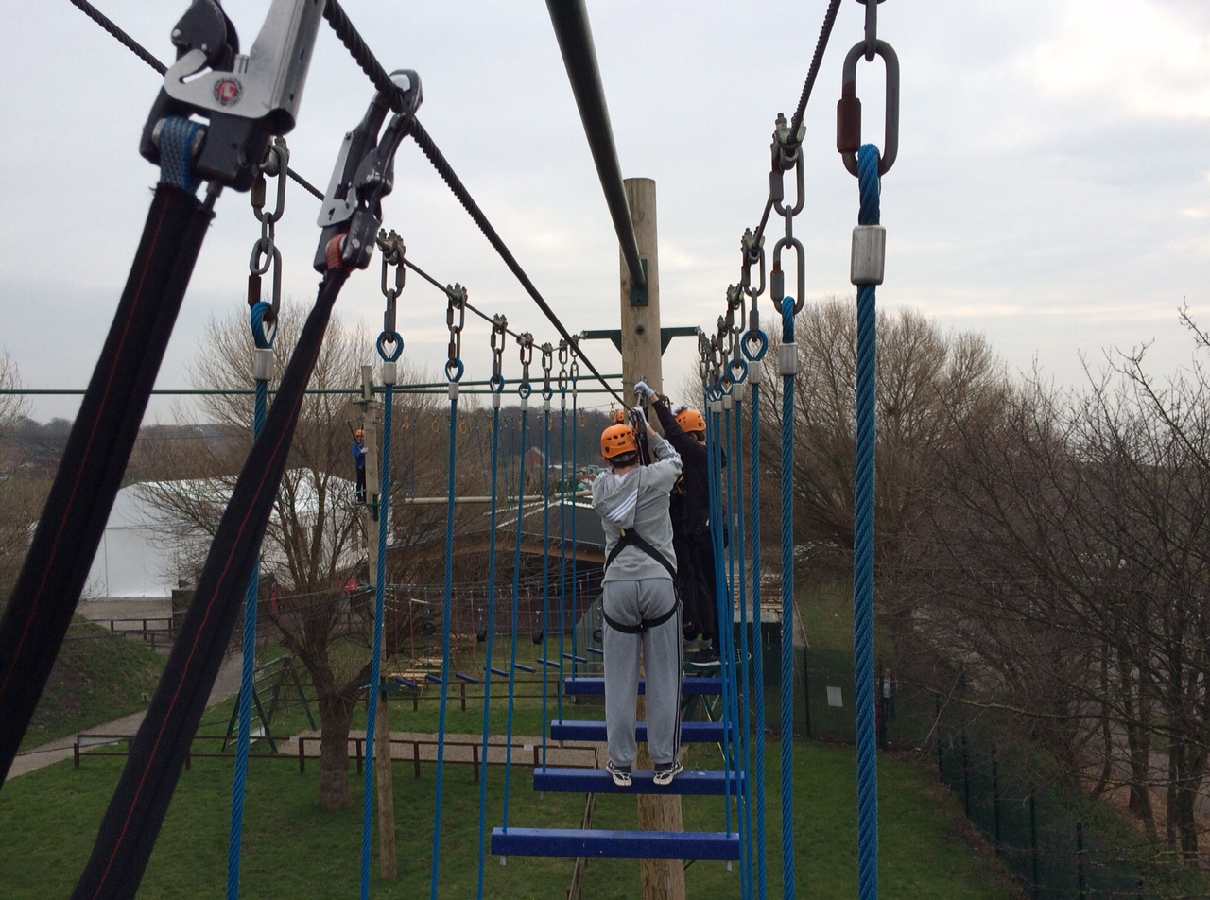
Friendship

Slide 18
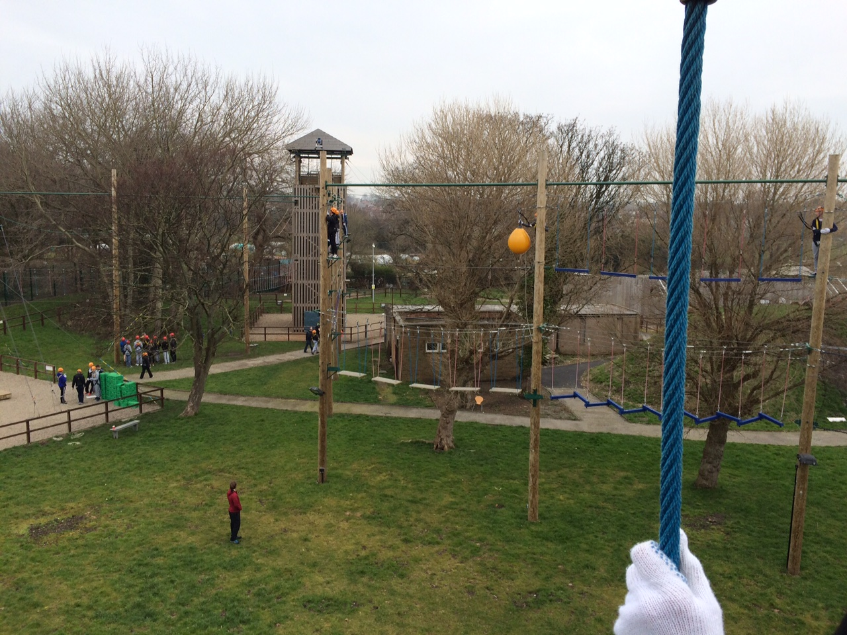
Trust

Slide 19
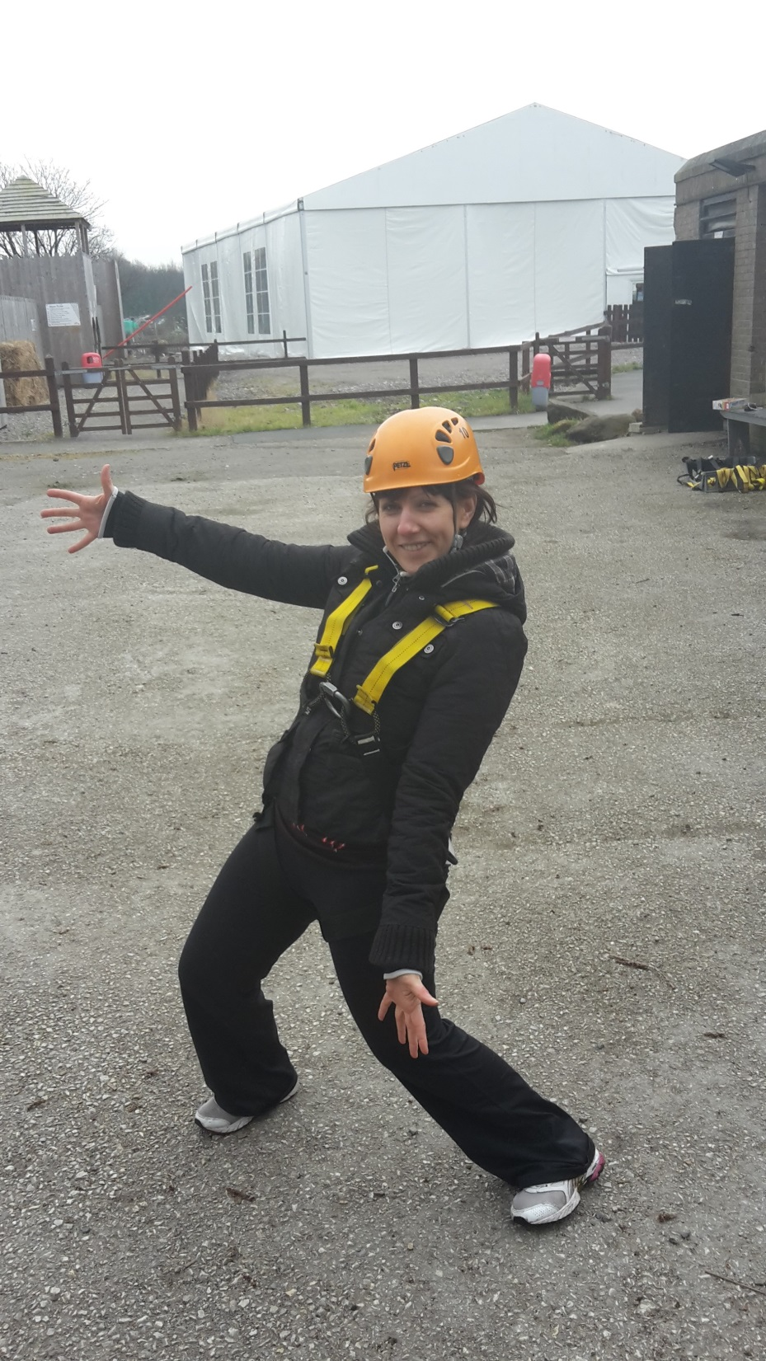
Wisdom

Slide 20
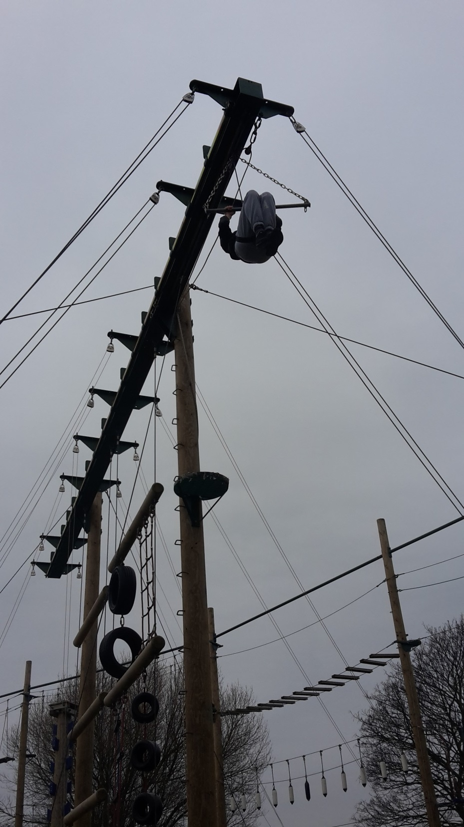
Endurance

Slide 21
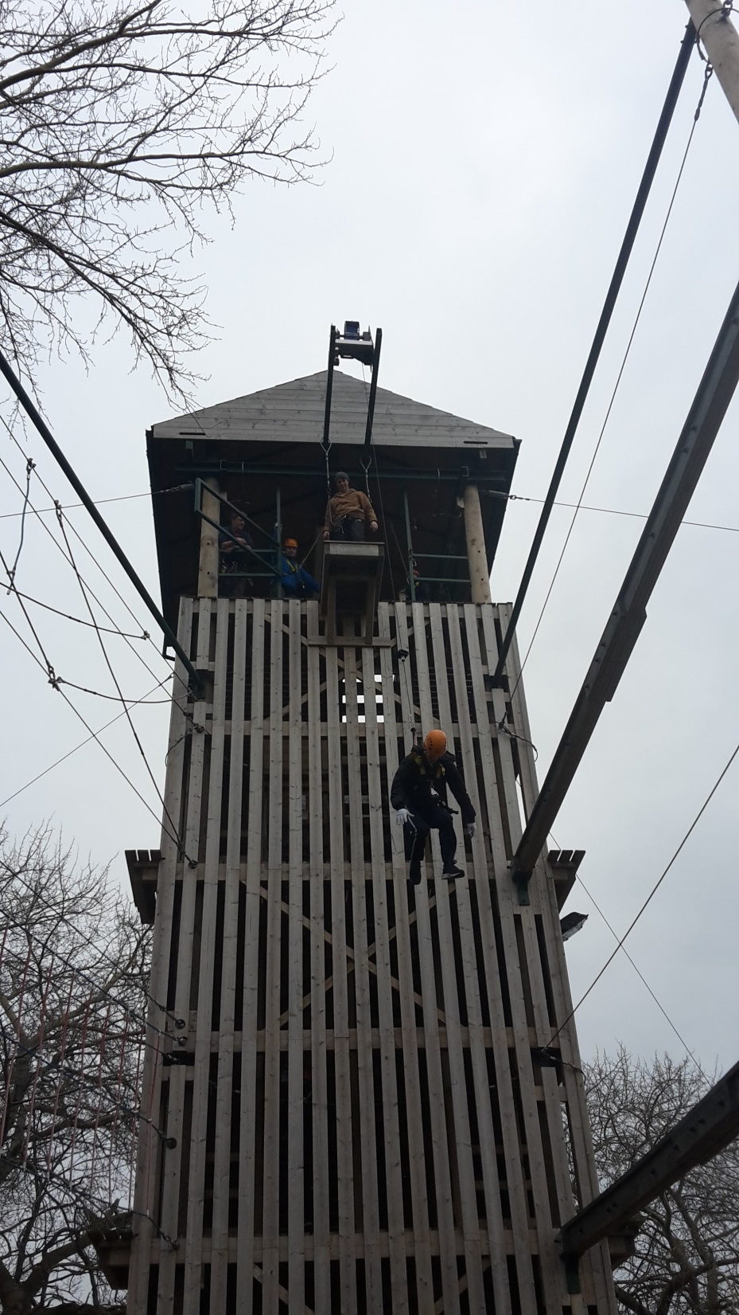
Trust

Slide 22
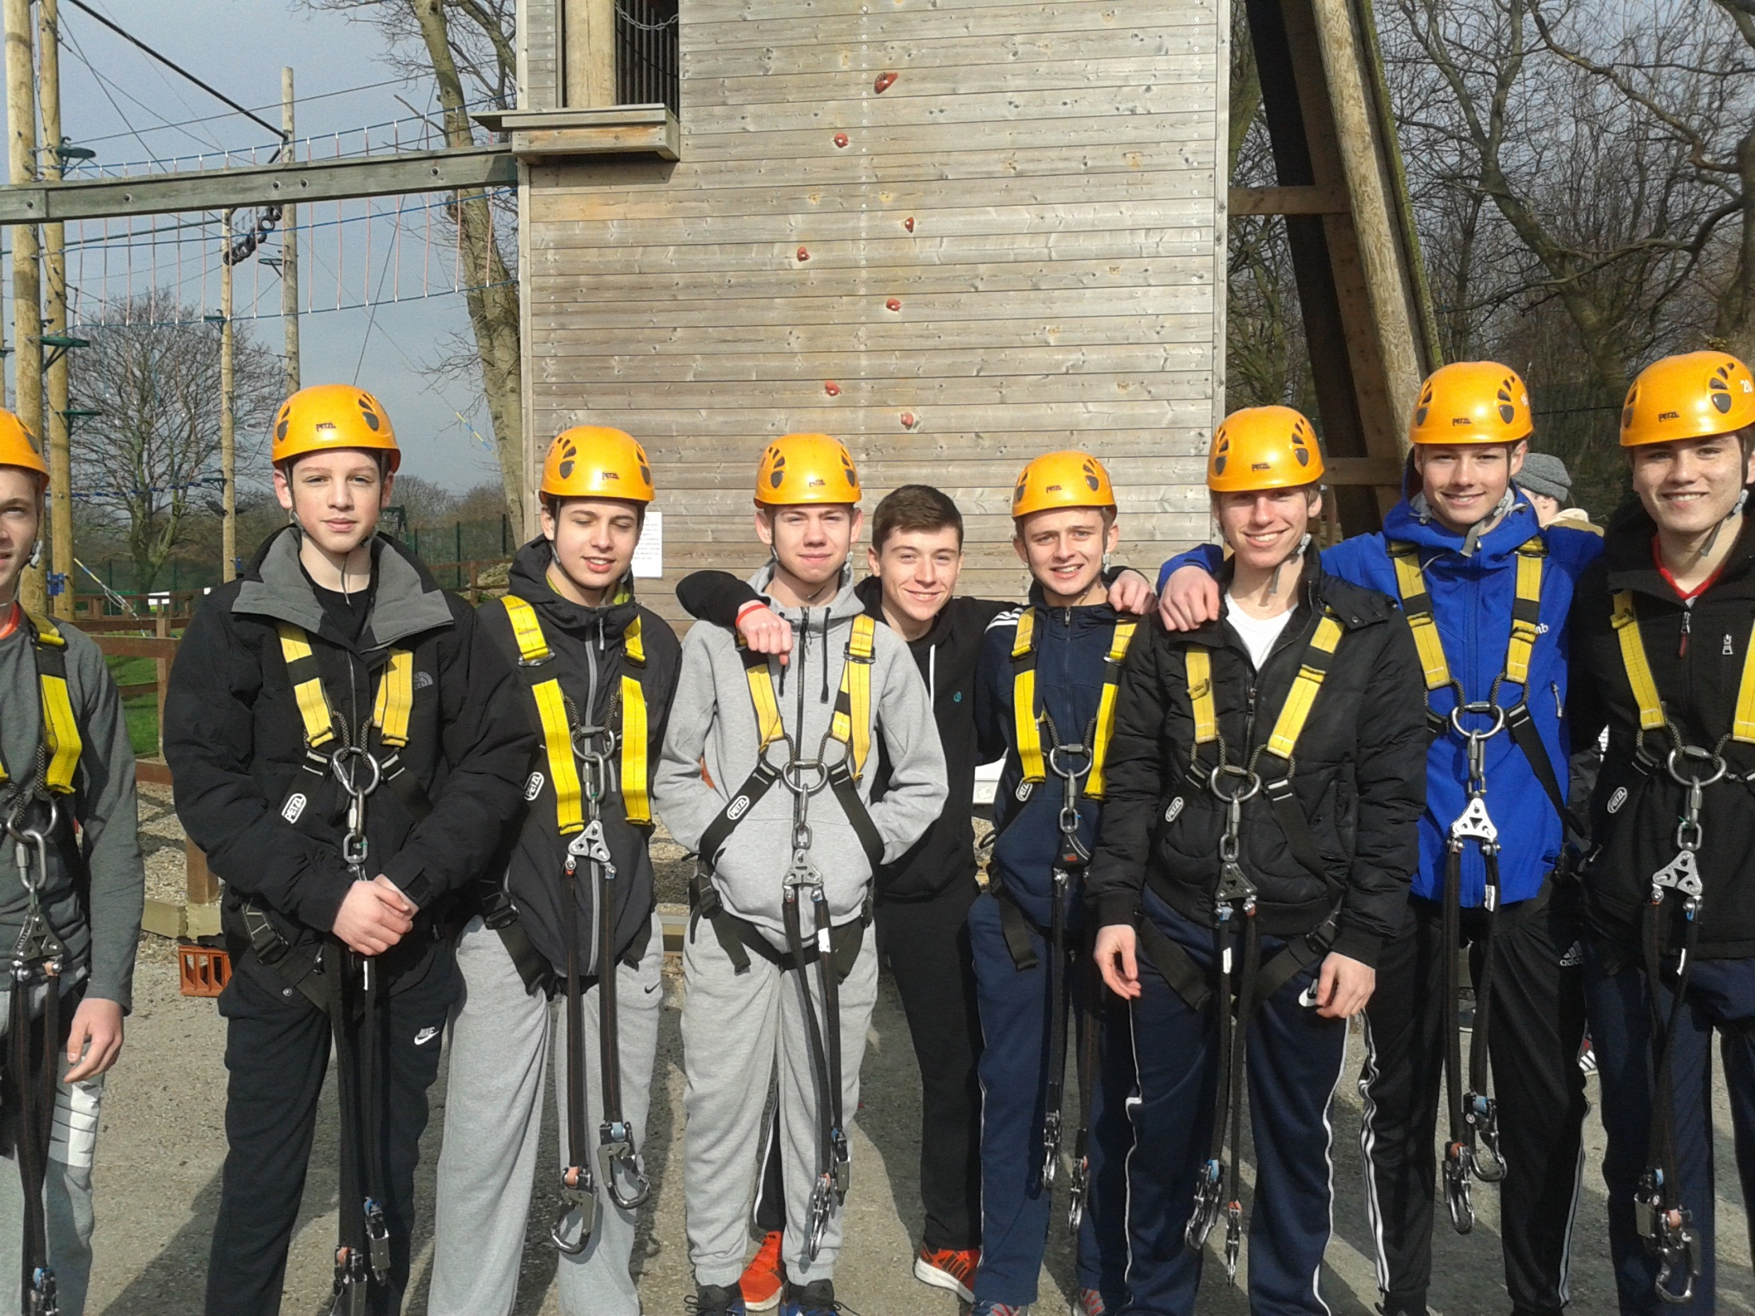
Friendship

Slide 23
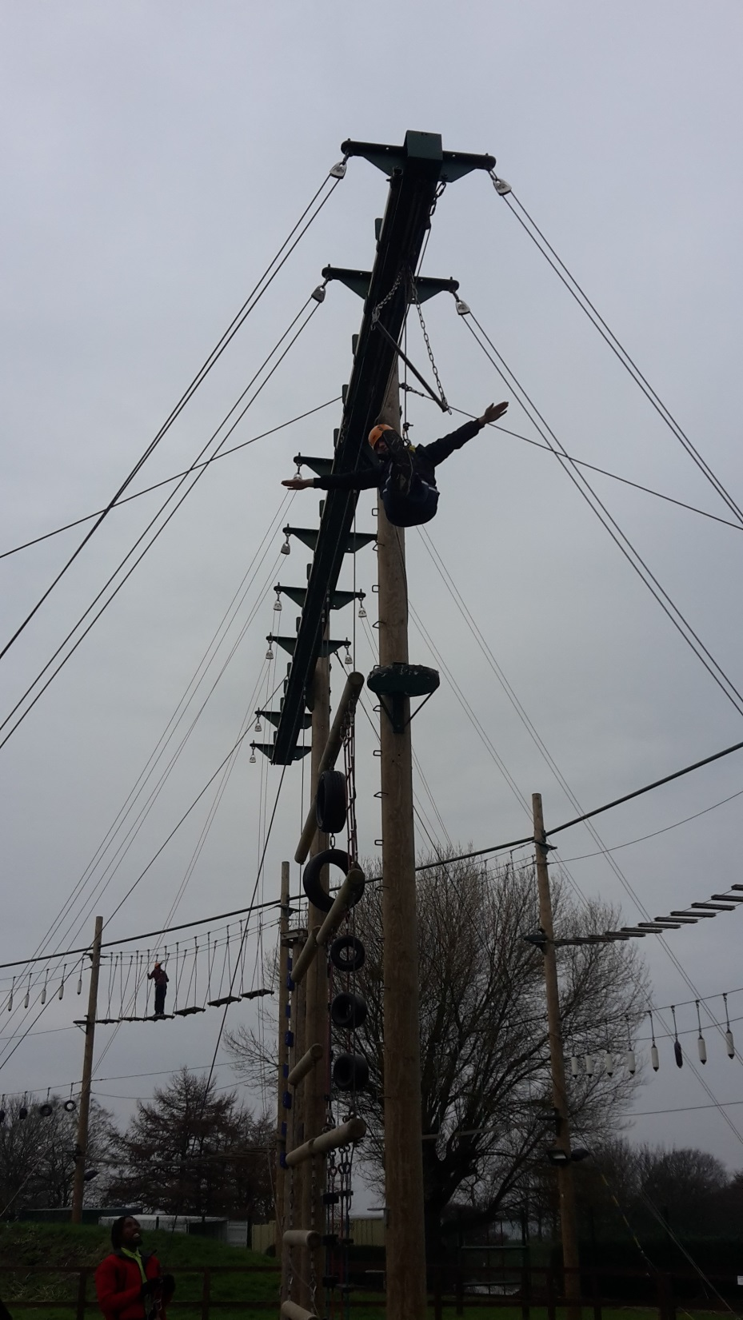
Friendship

Slide 24
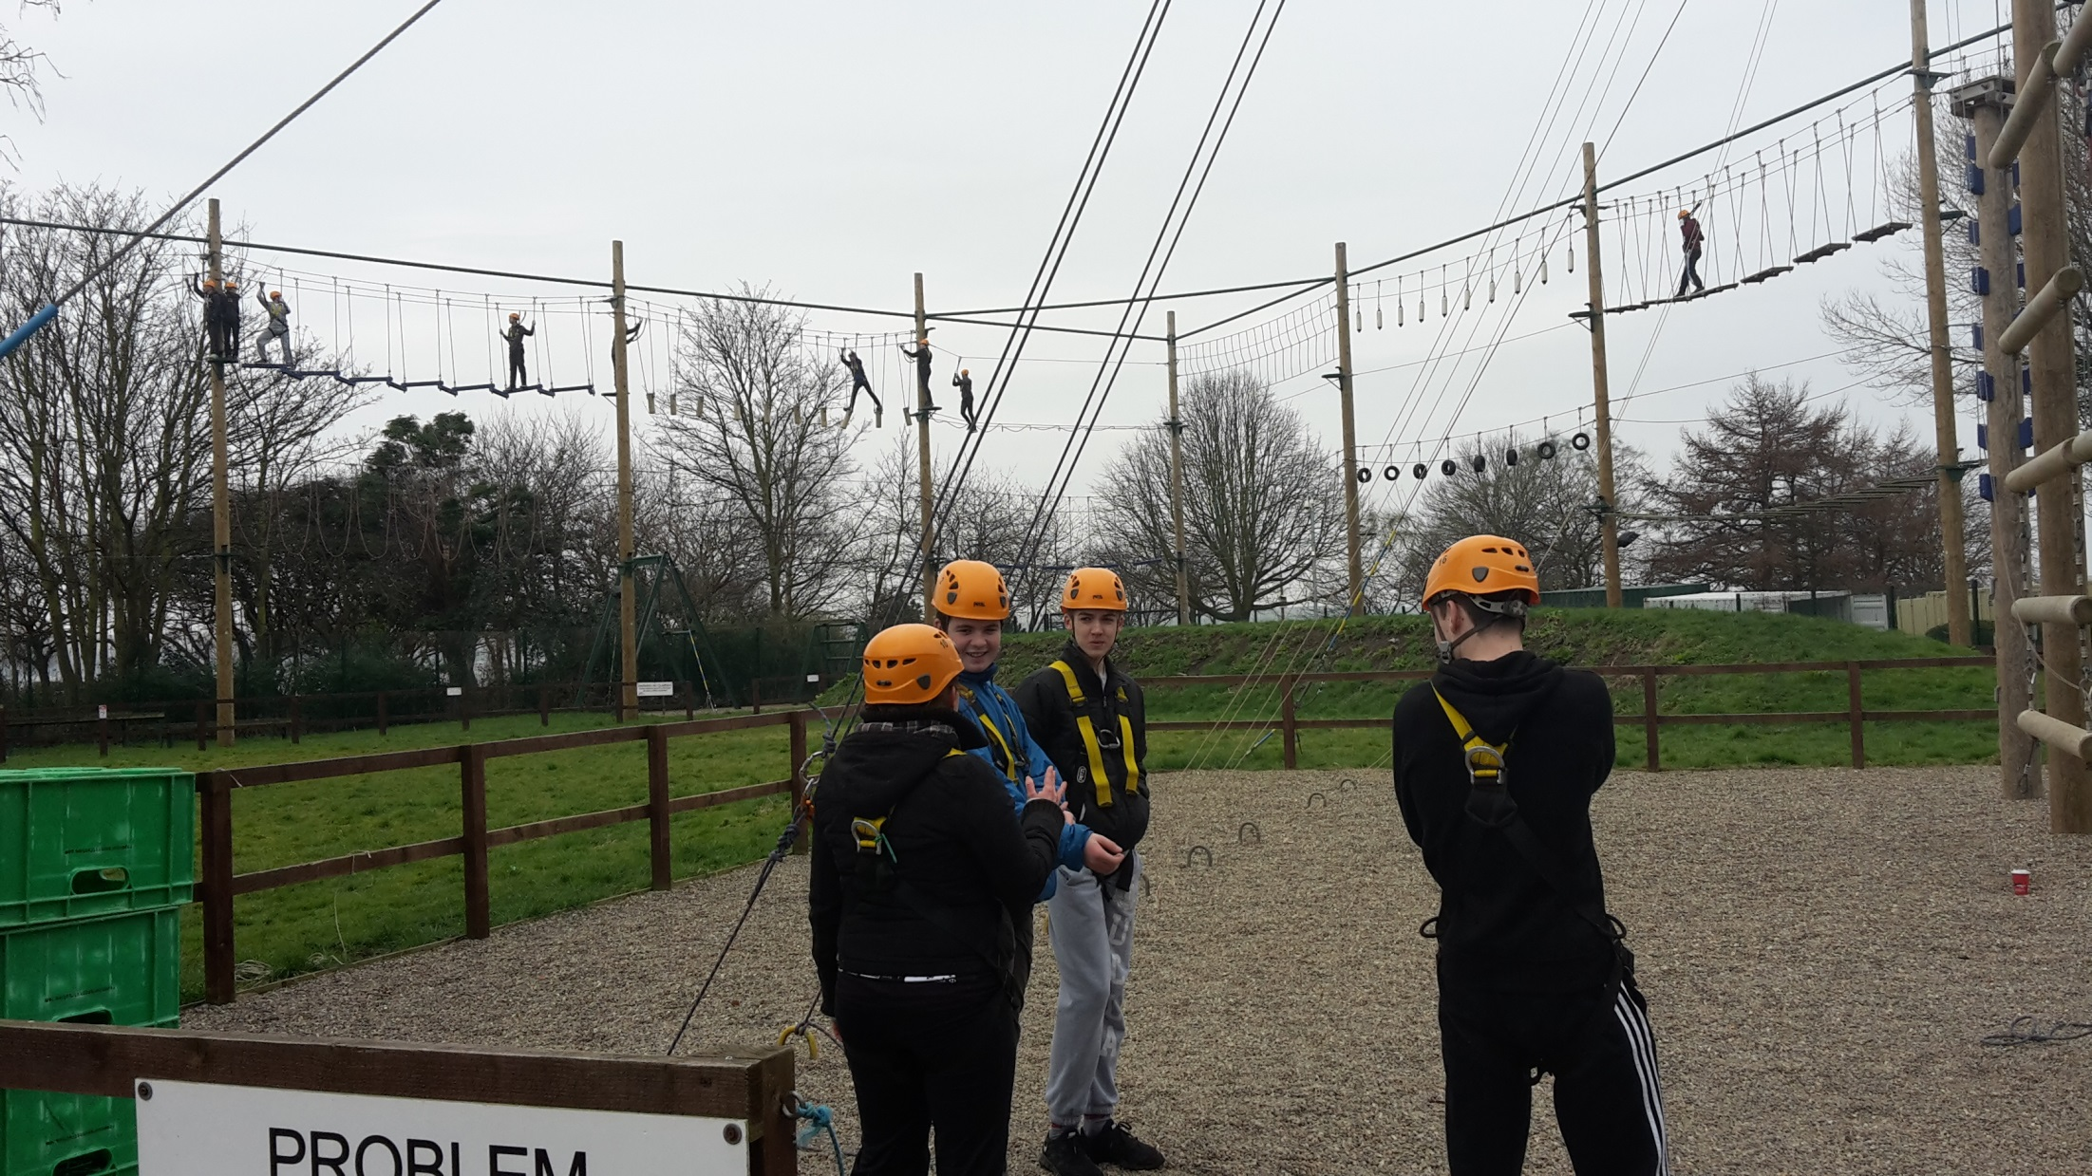
Wisdom

Slide 25
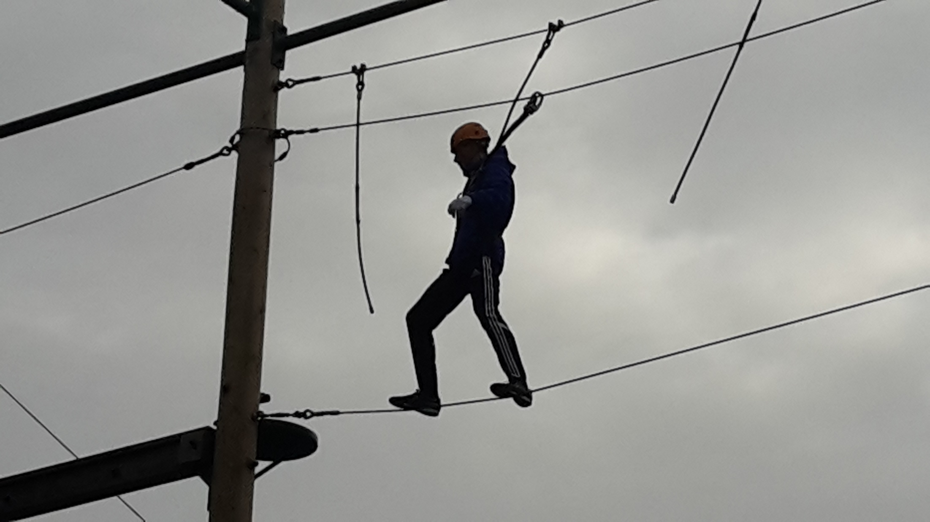
Trust

Slide 26
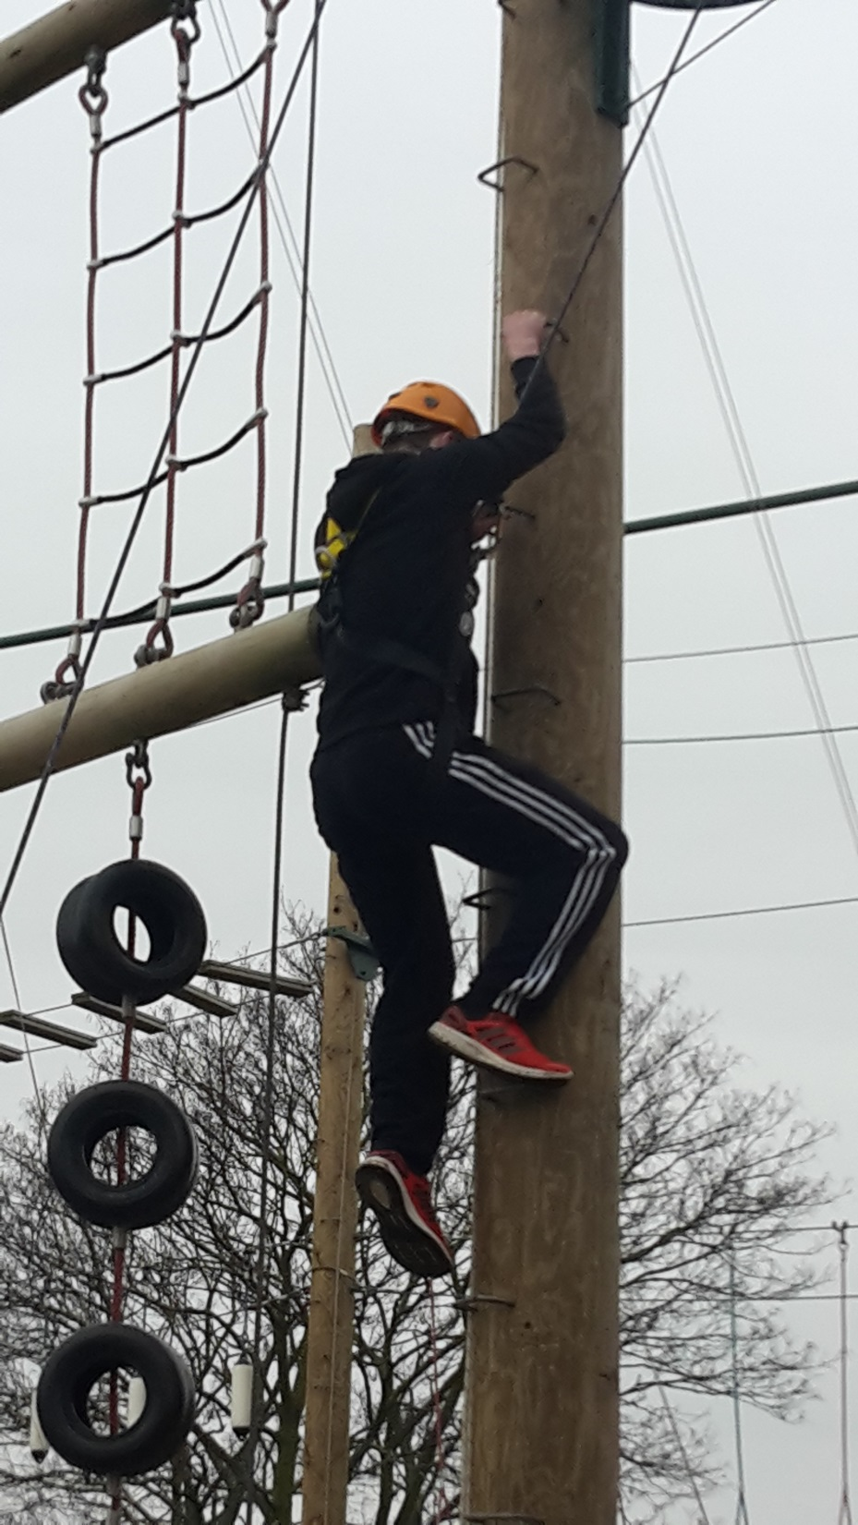
Endurance

Slide 27
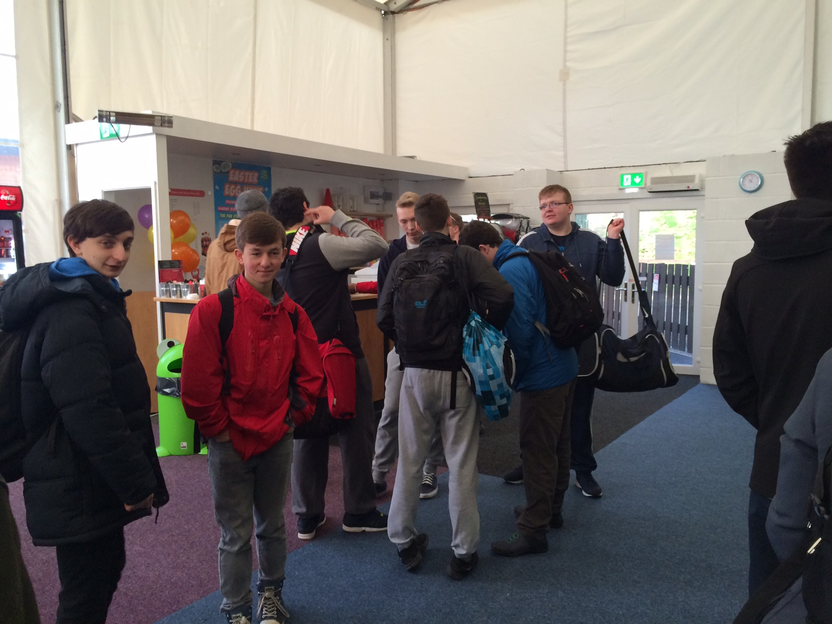
Friendship

Slide 28
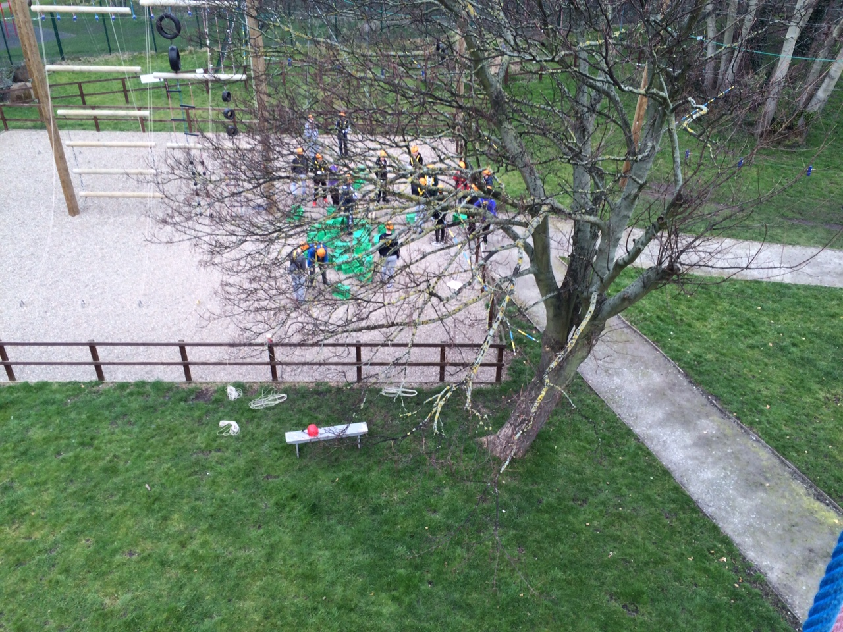
Trust

Slide 29
Well done
Thank you for all your hard work with volunteering.
We are very proud of what you have achieved.
Your hard work means the school has achieved awards such as;
Top volunteering scheme in England 2013/14 and the Diana Award.
Well done from
Miss Kinloch
Friendship

